Slide 1
Shipping Interlibrary Loan Materials

Slide 2
Outline
What and who is TRAC
Mail
Canada Post Shipping Tool
System Courier
Government Courier
Requests from outside TRAC

Slide 3
What is “TRAC”?
TRAC is an acronym for “The Regional Automation Consortium”, whose member systems are:
Peace Library System
Marigold Library System
Northern Lights Library System
Yellowhead Regional Library System
Your library is one of over 170 member libraries, who share collections through the shared Polaris catalogue.

Slide 4
Who’s who?
KEY: |  |  | Alberta TRAC Libraries
Yellowhead System |  |  | Northern Lights System |  |  | Peace Library System
 |  |  | Marigold System
 | G | Gov't Courier |  | M | Mail |  | S | System Van Run
AABM | S | AB Beach Public | AFL | M | Flatbush | APRPLS | G | Peace Library Syst.
AAF | S | Alder Flats Public | AFV | G | Fairview L | APV | S | Paradise Valley - Three Cities
AAIM | G | Airdrie Public | AFVC | G | Fort Vermilion L | ARAD | S | Radway
AAM | S | Acme Municipal Library | AGC | G | Grande Cache | AREP | M | Red Earth Public Library
AAS | S | Ashmont PL | AGCM | G | Cold Lake (also ACLM) | ARED | S | Redwater
AATH | G | Athabasca - Alice Donahue | AGI | S | Gibbons | ARLM | M | Rainbow Lake
AAVA | S | Acadia Valley | AGM | S | Gleichen | ARM | S | Rockyford
ABAR | S | Beaverlodge | AGP | G | Grande Prairie | AROC | S | Rochester
ABARR | G | Barrhead PL | AGRAS | S | Grassland S | ARYM | S | Rycroft
ABC | M | Brownvale L | AGWM | G | Grimshaw | ARUM | S | Rumsey
ABCBC | M | Bear Point L | AH | G | Hinton | ARV | S | Rich Valley
ABDSRC | S | Sheep River - Blk Dmnd | AHCM | S | Hines Creek | ARY | S | McPherson L - Ryley
ABEAM | S | Bib de Beaumont | AHL | G | High Level | ASANS | S | Sangudo
ABEM | S | Beiseker | AHM | G | Hanna | ASB | S | Seba Beach
ABM | G | Bonnyville | AHOM | S | Holden | ASG | G | Spruce Grove
ABOA | S | Bon Accord | AHPM | G | High Prairie | ASGY | G | Yellowhead HQ
ABON | S | Bonanza | AHRM | G | High River | ASH | G | Swan Hills L
ABOY | G | Boyle | AHUM | S | Hussar | ASIC | S | Bib de St. Isidore
ABRC | S | Blue Ridge | AHYM | S | Hythe | ASL | G | Smoky Lake
ABRM | S | Breton | AIP | S | Village of Innisfree | ASLM | G | Rotary Club of Slave Lake
ABRUM | S | Metro Kalyn C - Bruderheim | AIRC | S | Irma | ASM | G | Strathmore
ABWM | S | Berwyn | AI | S | Irricana | ASMLS | G | Marigold HQ
ACALM | S | Calmar | AJ | S | Jasper | ASP | G | Stony Plain
ACAM | G | Canmore | AJA | S | Jarvie L | ASRM | G | Spirit River
ACARM | S | Carbon | AKC | M | Keg River | ASRSM | S | Savanna
ACARSE | S | Carseland | AKEC | S | Keephills | ASSCL | M | Smith
ACC | S | Berry Cr. - Cessford | AK | S | Kitscoty Public Library | ASSM | S | Sexsmith
ACERM | S | Cereal | AKM | M | Kinuso | ASTM | S | Standard
ACHES | G | Chestermere | ALAAC | S | Pigeon Lake | ASTP | G | St. Paul
ACHM | S | Chauvin Municipal Library | ALE | G | Leduc | ATAN | M | Tangent
ACLM | G | Cold Lake - Harbour View (AGCM) | ALGC | S | La Glace | ATHI | S | Alice Melnyk - Two Hills
ACLMSC | S | Menno-Simons L | ALLB | G | Stuart MacPherson / Lac La Biche | ATHM | G | Three Hills
ACLPL | M | Calling Lake | ALM | S | Linden | ATHOM | S | Thorhild
ACOM | G | Nan Boothby Mem -Cochrane | ALOM | S | Longview | ATM | S | Thorsby
ACONM | G | Consort | ALPEG | S | Edmonton Garrison | ATO | S | Tomahawk
ACRM | S | Crossfield Municipal Library | AMA | S | Mayerthorpe | ATOF | G | Tofield
AD | G | Devon | AMAL | S | Mallaig | ATRM | S | Trochu
ADAR | S | Darwell | AMAM | G | Manning | AVCM | S | Valhalla
ADC | S | DeBolt | AMAN | S | Mannville | AVE | G | Vegreville L
ADIX | S | Dixonville | AMAR | S | Marwayne | AVER | G | Vermilion L
ADM | S | Delia | AMC | S | Millarville | AVI | S | Vilna
ADRM | G | Drumheller | AME | G | 4 Wing (CFB - Cold Lake) | AVIK | S | Viking
ADUF | S | Duffield | AMI | S | Millet | AVVM | G | Valleyview
ADV | G | Drayton Valley | AMLM | G | McLennan | AW | G | Wetaskiwin
AEAM | S | Eaglesham | AMML | S | Mundare | AWA | S | Warburg
AELC | S | Elmworth | AMO | G | Morinville | AWAIC | G | Wainright
AED | G | Edson | AMOM | S | Morrin | AWAS | S | Anne Chorney - Waskatenau
AEDG | S | Edgerton | AMYR | S | Myrnam | AWD | S | Worsley
AELK | G | Elk Point | AN S |  | Neerlandia | AWEM | S | Wembley
AEM | S | Empress | ANE | S | Newbrook | AWES | G | Westlock
AENT | S | Entwistle | ANJGG | S | Niton (Greengrove) | AWH | G | Whitecourt
AEPNL | G | Northern Lights HQ | ANM | S | Nampa | AWI | S | Winfield
AEV | G | Evansburg | ANS | S | New Sarepta | AWILD | S | Wildwood
AEXC | S | Bighorn | AO | S | Onoway L | AWM | S | Wabamun
AFA | S | Fort Assiniboine L | AOM | S | Okotoks | AWO | S | Woking
AFAW | S | M Alice Frose - Fawcett | AOYM | G | Oyen | AWR | S | Wandering R.Women's Instit.
AFCM | G | Fox Creek L | APL | S | Plamondon | AWWA | M | Wabasca
AFD | G | Bib Dentinger | APPP | M | Paddle Prairie Public | AYM | S | Youngstown
 |  |  | APRM | G | Peace River |  |  | 07-Feb-13
Your library should regularly request (or download from the PLS website) the most current version of this colorful guide to the TRAC member libraries:
acronym
system membership and
how it ships and receives loans:
Mail
System Courier or
Government Courier

Slide 5
Who’s who?
A close up view of the chart shows, for example, that Ashmont Public Library (AAS), member of the Northern Lights Library System has items delivered by System Courier (S), and the Alice Donahue Library in Athabasca (AATH), also a Northern Lights Library, has access to a Government Courier (G) service point in Alberta.
To satisfy a request from Bear Point, send by mail (M).
KEY: |  |  | Alberta TRAC Libraries
Yellowhead System |  |  | Northern Lights System
 |  |  | Marigold System
 | G | Gov't Courier |  | M | Mail
AABM | S | AB Beach Public | AFL | M | Flatbush
AAF | S | Alder Flats Public | AFV | G | Fairview L
AAIM | G | Airdrie Public | AFVC | G | Fort Vermilion L
AAM | S | Acme Municipal Library | AGC | G | Grande Cache
AAS | S | Ashmont PL | AGCM | G | Cold Lake (also ACLM)
AATH | G | Athabasca - Alice Donahue | AGI | S | Gibbons
AAVA | S | Acadia Valley | AGM | S | Gleichen
ABAR | S | Beaverlodge | AGP | G | Grande Prairie
ABARR | G | Barrhead PL | AGRAS | S | Grassland S
ABC | M | Brownvale L | AGWM | G | Grimshaw
ABCBC | M | Bear Point L | AH | G | Hinton
ABDSRC | S | Sheep River - Blk Dmnd | AHCM | S | Hines Creek
ABEAM | S | Bib de Beaumont | AHL | G | High Level
ABEM | S | Beiseker | AHM | G | Hanna

Slide 6
Getting items to and from 170 libraries…
Mail – small libraries located some distance from their system headquarters receive and lend material by mail. Postage is paid by the library and reimbursed by headquarters. Rates are very low, using the Canada Post Shipping Tool and include free return shipping.
System courier – libraries closer to their system headquarters loan and borrow material via weekly van runs to and from headquarters.
Government Courier – libraries located in towns and cities which have Alberta Government Courier delivery locations can also send and receive fully addressed packages through this courier.

Slide 7
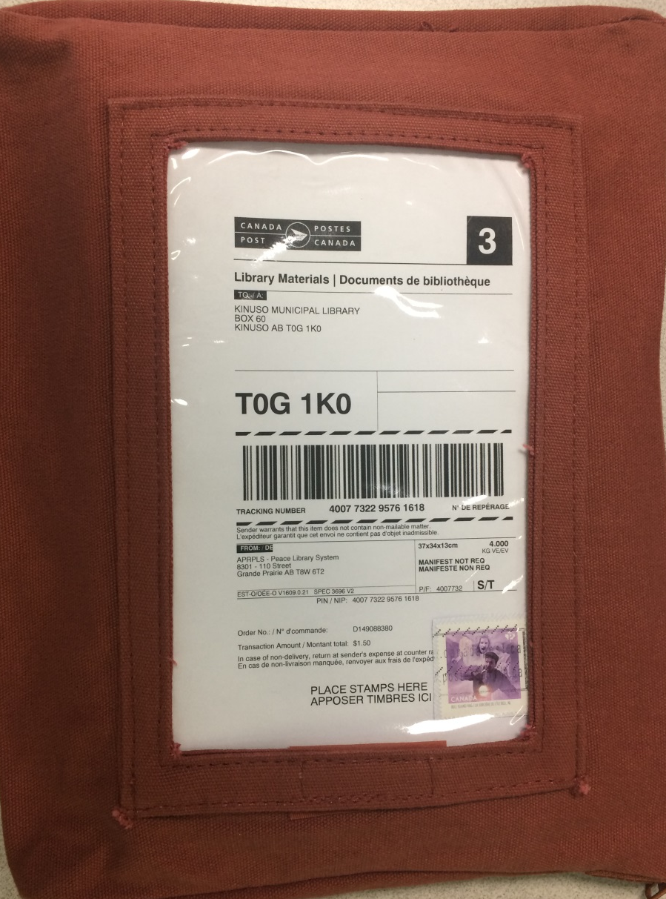
Mail Shipments
Brown fabric bags (two different sizes)are designed to ship books by mail: to a 5 KG limit per package. They have a large window to display the label generated by the Canada Post Shipping Tool.

Slide 8
Mail Shipments
The label must have correct postage affixed: whether you use a credit card, stamps or a meter generated postage sticker.

Slide 9
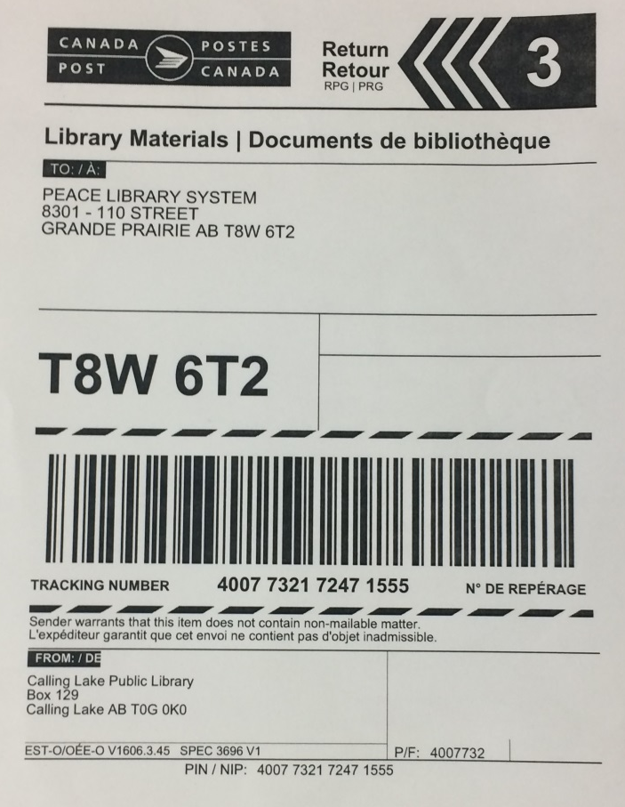
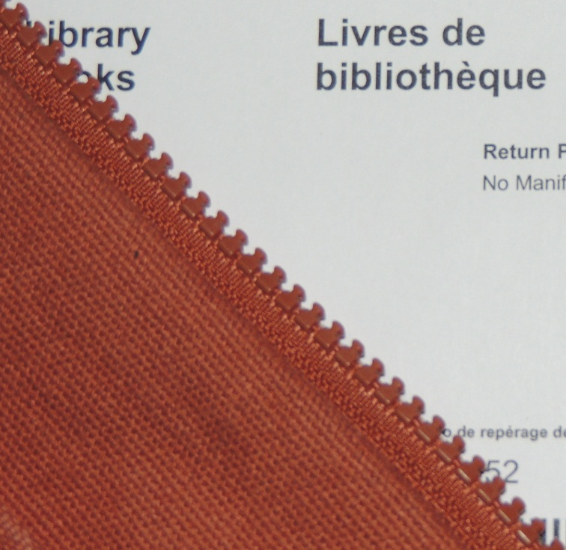
Mail Shipments
Include inside the bag, with the item, the shipping label for return of the item to its home branch which does not require additional postage.

Slide 10
Canada Post Shipping Tool
The Canada Post website provides this sample of the correct format for addressing mail. (This format should also be used when shipping via Government Courier.)
http://www.canadapost.ca/cpo/mc/personal/guides/addressing.jsf

Slide 11
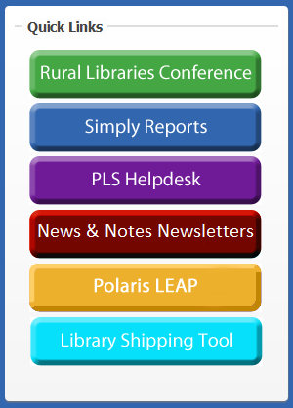
Canada Post Shipping Tool
The bottom “Quick Link” on the PLS Website Home Page opens the web site for the “Canada Post Shipping Tool for the Canadian Library Materials Service” administered by Canadian Urban Libraries Council / Conseil des Bibliothèques Urbaines du Canada (CULC/CBUC).

Slide 12
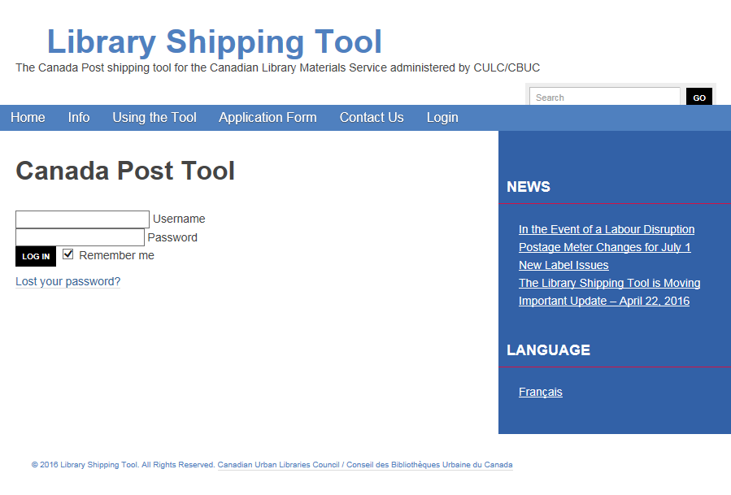
Canada Post Shipping Tool
Click on the Login heading. Enter your library 5 digit numeric “Username”. Enter your postal code (without a space) as your password. Click Log In.
Optional:
Change language preference to French.

Slide 13
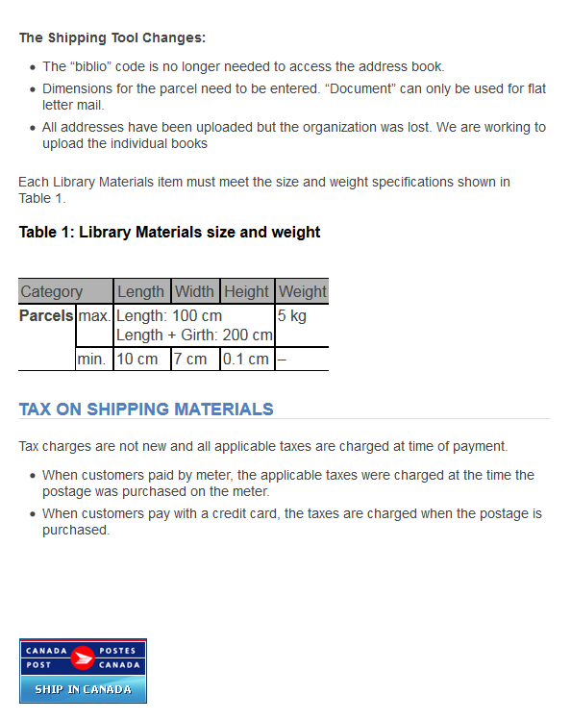
Canada Post Shipping Tool
Review the instructions on the page that opens, and SCROLL DOWN to find the Canada Post Link to the Shipping Tool.
Click on this image.

Slide 14
Canada Post Shipping Tool
‘

Slide 15
Canada Post Shipping Tool
On the left side click on “Retrieve from Address Book” to find your (return) address.

Slide 16
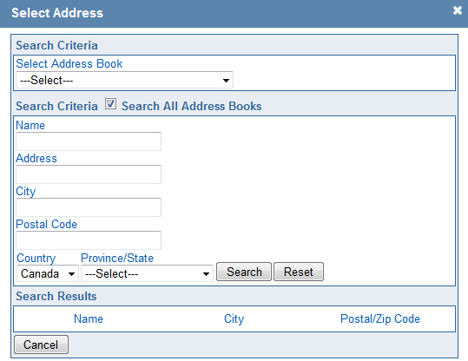
Canada Post Shipping Tool
Click the check box:
“Search Criteria R Search All Address Books”.
Enter the library name or the city in the appropriate field.
Click on search.
Selecting the library from the resulting list populates the form with all the address details.

Slide 17
Canada Post Shipping Tool
On the right (“To”) side, click on “Retrieve from Address Book” to find the destination address in the same way.

Slide 18
Canada Post Shipping Tool
The address book should contain all libraries, but if a library happens to be missing, both the return and destination addresses can be entered manually.
Please report missing addresses to PLS headquarters.

Slide 19
Canada Post Shipping Tool
Weigh the bagged item and enter the weight in kg rounding up to the nearest even number (and not exceeding 5 kg).
Enter the bag dimensions in cm.
“Library Books” should be the default service option in the next section.

Slide 20
Canada Post Shipping Tool
Select the “Method of payment” from the “Payment Information” section, and then click on “Calculate”.

Slide 21
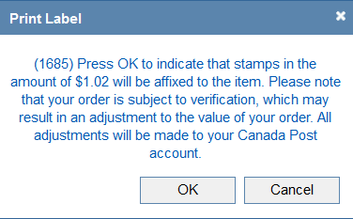
Canada Post Shipping Tool
Once the postage rate is calculated for your package, a reminder message about affixing stamps will pop up. Click on OK to proceed to the page where you print the label.

Slide 22
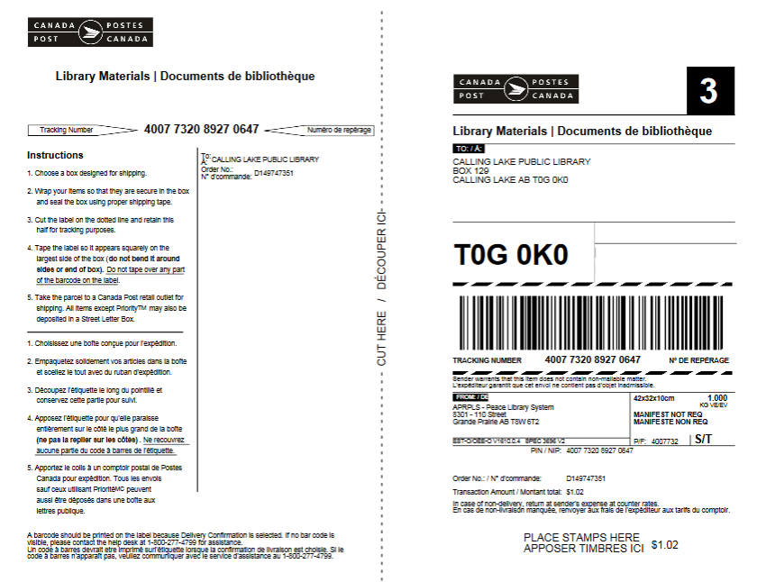
Canada Post Shipping Tool
Be sure to print the mailing label before clicking on
“Generate a Return Label”.
Print

Slide 23
Shipping by Government Courier
All shipments sent through government courier must be fully addressed using the Canada Post standard:

Slide 24
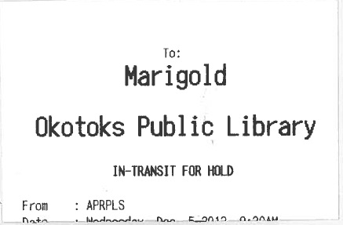
Shipping by Government Courier
Acceptable labels
Not Acceptable Government Courier drivers CANNOT deliver items labelled like this.
GOV’T COURIER
AEPNL
Northern Lights Library System
Bag 8
Elk Point, AB T0A 1A0
Northern Lights Library System
P.O. Bag 8
ELK POINT AB T0A IA0
GOV’T COURIER

Slide 25
Shipping by Government Courier
Double bagging: Use the in-transit receipt, which a System Courier CAN deliver, inside a bag, box, or bin fully addressed, to satisfy Government Courier
Marigold Library System
710 - 2 Street
STRATHMORE AB T1P 1K4
ATTN: ILL GOVT COURIER

Slide 26
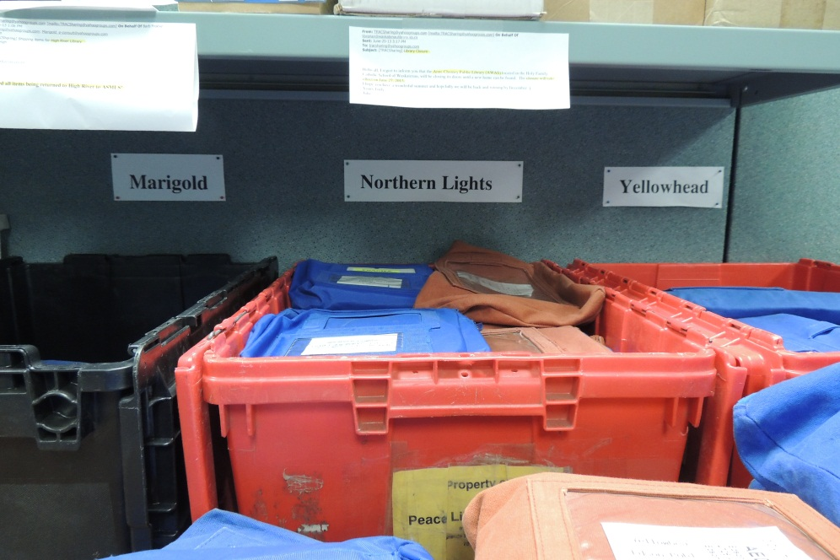
Shipping by Government Courier
Double bagging: Use the in-transit receipt, which a System Courier CAN deliver, inside a bag, box, or bin fully addressed, to satisfy Government Courier.

Slide 27
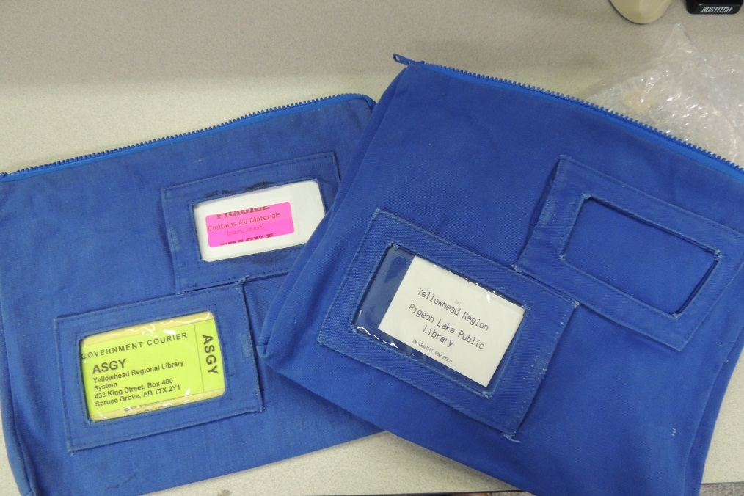
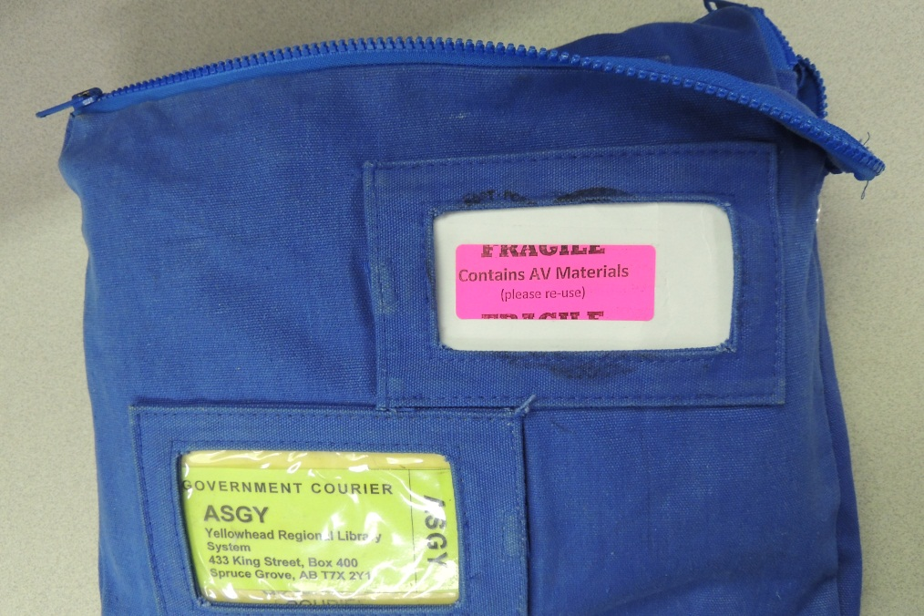
Shipping by Government Courier
Double bagging: Use the in-transit receipt, which a System Courier CAN deliver, inside a bag, box, or bin fully addressed, to satisfy Government Courier.

Slide 28
Shipping by Government Courier
When Yellowhead Regional Library System receives this from Government Courier, the inside bag will go into their System Courier run for delivery to Pigeon Lake, which they can drive to without a delivery address.

Slide 29
“Mail Only Library” requests
KEY: |  |  | Alberta TRAC Libraries
Yellowhead System |  |  | Northern Lights System |  |  | Peace Library System
 |  |  | Marigold System
 | G | Gov't Courier |  | M | Mail |  | S | System Van Run
AABM | S | AB Beach Public | AFL | M | Flatbush | APRPLS | G | Peace Library Syst.
AAF | S | Alder Flats Public | AFV | G | Fairview L | APV | S | Paradise Valley - Three Cities
AAIM | G | Airdrie Public | AFVC | G | Fort Vermilion L | ARAD | S | Radway
AAM | S | Acme Municipal Library | AGC | G | Grande Cache | AREP | M | Red Earth Public Library
AAS | S | Ashmont PL | AGCM | G | Cold Lake (also ACLM) | ARED | S | Redwater
AATH | G | Athabasca - Alice Donahue | AGI | S | Gibbons | ARLM | M | Rainbow Lake
AAVA | S | Acadia Valley | AGM | S | Gleichen | ARM | S | Rockyford
ABAR | S | Beaverlodge | AGP | G | Grande Prairie | AROC | S | Rochester
ABARR | G | Barrhead PL | AGRAS | S | Grassland S | ARYM | S | Rycroft
ABC | M | Brownvale L | AGWM | G | Grimshaw | ARUM | S | Rumsey
ABCBC | M | Bear Point L | AH | G | Hinton | ARV | S | Rich Valley
ABDSRC | S | Sheep River - Blk Dmnd | AHCM | S | Hines Creek | ARY | S | McPherson L - Ryley
ABEAM | S | Bib de Beaumont | AHL | G | High Level | ASANS | S | Sangudo
ABEM | S | Beiseker | AHM | G | Hanna | ASB | S | Seba Beach
ABM | G | Bonnyville | AHOM | S | Holden | ASG | G | Spruce Grove
ABOA | S | Bon Accord | AHPM | G | High Prairie | ASGY | G | Yellowhead HQ
ABON | S | Bonanza | AHRM | G | High River | ASH | G | Swan Hills L
ABOY | G | Boyle | AHUM | S | Hussar | ASIC | S | Bib de St. Isidore
ABRC | S | Blue Ridge | AHYM | S | Hythe | ASL | G | Smoky Lake
ABRM | S | Breton | AIP | S | Village of Innisfree | ASLM | G | Rotary Club of Slave Lake
ABRUM | S | Metro Kalyn C - Bruderheim | AIRC | S | Irma | ASM | G | Strathmore
ABWM | S | Berwyn | AI | S | Irricana | ASMLS | G | Marigold HQ
ACALM | S | Calmar | AJ | S | Jasper | ASP | G | Stony Plain
ACAM | G | Canmore | AJA | S | Jarvie L | ASRM | G | Spirit River
ACARM | S | Carbon | AKC | M | Keg River | ASRSM | S | Savanna
ACARSE | S | Carseland | AKEC | S | Keephills | ASSCL | M | Smith
ACC | S | Berry Cr. - Cessford | AK | S | Kitscoty Public Library | ASSM | S | Sexsmith
ACERM | S | Cereal | AKM | M | Kinuso | ASTM | S | Standard
ACHES | G | Chestermere | ALAAC | S | Pigeon Lake | ASTP | G | St. Paul
ACHM | S | Chauvin Municipal Library | ALE | G | Leduc | ATAN | M | Tangent
ACLM | G | Cold Lake - Harbour View (AGCM) | ALGC | S | La Glace | ATHI | S | Alice Melnyk - Two Hills
ACLMSC | S | Menno-Simons L | ALLB | G | Stuart MacPherson / Lac La Biche | ATHM | G | Three Hills
ACLPL | M | Calling Lake | ALM | S | Linden | ATHOM | S | Thorhild
ACOM | G | Nan Boothby Mem -Cochrane | ALOM | S | Longview | ATM | S | Thorsby
ACONM | G | Consort | ALPEG | S | Edmonton Garrison | ATO | S | Tomahawk
ACRM | S | Crossfield Municipal Library | AMA | S | Mayerthorpe | ATOF | G | Tofield
AD | G | Devon | AMAL | S | Mallaig | ATRM | S | Trochu
ADAR | S | Darwell | AMAM | G | Manning | AVCM | S | Valhalla
ADC | S | DeBolt | AMAN | S | Mannville | AVE | G | Vegreville L
ADIX | S | Dixonville | AMAR | S | Marwayne | AVER | G | Vermilion L
ADM | S | Delia | AMC | S | Millarville | AVI | S | Vilna
ADRM | G | Drumheller | AME | G | 4 Wing (CFB - Cold Lake) | AVIK | S | Viking
ADUF | S | Duffield | AMI | S | Millet | AVVM | G | Valleyview
ADV | G | Drayton Valley | AMLM | G | McLennan | AW | G | Wetaskiwin
AEAM | S | Eaglesham | AMML | S | Mundare | AWA | S | Warburg
AELC | S | Elmworth | AMO | G | Morinville | AWAIC | G | Wainright
AED | G | Edson | AMOM | S | Morrin | AWAS | S | Anne Chorney - Waskatenau
AEDG | S | Edgerton | AMYR | S | Myrnam | AWD | S | Worsley
AELK | G | Elk Point | AN S |  | Neerlandia | AWEM | S | Wembley
AEM | S | Empress | ANE | S | Newbrook | AWES | G | Westlock
AENT | S | Entwistle | ANJGG | S | Niton (Greengrove) | AWH | G | Whitecourt
AEPNL | G | Northern Lights HQ | ANM | S | Nampa | AWI | S | Winfield
AEV | G | Evansburg | ANS | S | New Sarepta | AWILD | S | Wildwood
AEXC | S | Bighorn | AO | S | Onoway L | AWM | S | Wabamun
AFA | S | Fort Assiniboine L | AOM | S | Okotoks | AWO | S | Woking
AFAW | S | M Alice Frose - Fawcett | AOYM | G | Oyen | AWR | S | Wandering R.Women's Instit.
AFCM | G | Fox Creek L | APL | S | Plamondon | AWWA | M | Wabasca
AFD | G | Bib Dentinger | APPP | M | Paddle Prairie Public | AYM | S | Youngstown
 |  |  | APRM | G | Peace River |  |  | 07-Feb-13
Is your item going to a PLS library (not highlighted on the chart) or to one of the other TRAC libraries (highlighted in gold, green and pink) AND is it a “Mail Only Library”?
Item is requested at a
PLS “Mail Only Library”.
Use the Canada Post Shipping Tool and mail the item.
Item is requested at another
TRAC “Mail Only Library”.
Follow the instructions on the following page.

Slide 30
PLS ILL Mail Only Deliveries
If you are a Library with access to Government Courier
Government Courier items to Marigold, Yellowhead or Northern Lights Headquarters for their Mail only libraries.
If you are a System Courier Library without access to Government Courier
Forward items on the PLS van to PLS headquarters for Marigold, Yellowhead or Northern Lights Mail only libraries.
If you are a Mail Only Library
Mail ILL items to all Libraries

Slide 31
“System Courier Library” requests
KEY: |  |  | Alberta TRAC Libraries
Yellowhead System |  |  | Northern Lights System |  |  | Peace Library System
 |  |  | Marigold System
 | G | Gov't Courier |  | M | Mail |  | S | System Van Run
AABM | S | AB Beach Public | AFL | M | Flatbush | APRPLS | G | Peace Library Syst.
AAF | S | Alder Flats Public | AFV | G | Fairview L | APV | S | Paradise Valley - Three Cities
AAIM | G | Airdrie Public | AFVC | G | Fort Vermilion L | ARAD | S | Radway
AAM | S | Acme Municipal Library | AGC | G | Grande Cache | AREP | M | Red Earth Public Library
AAS | S | Ashmont PL | AGCM | G | Cold Lake (also ACLM) | ARED | S | Redwater
AATH | G | Athabasca - Alice Donahue | AGI | S | Gibbons | ARLM | M | Rainbow Lake
AAVA | S | Acadia Valley | AGM | S | Gleichen | ARM | S | Rockyford
ABAR | S | Beaverlodge | AGP | G | Grande Prairie | AROC | S | Rochester
ABARR | G | Barrhead PL | AGRAS | S | Grassland S | ARYM | S | Rycroft
ABC | M | Brownvale L | AGWM | G | Grimshaw | ARUM | S | Rumsey
ABCBC | M | Bear Point L | AH | G | Hinton | ARV | S | Rich Valley
ABDSRC | S | Sheep River - Blk Dmnd | AHCM | S | Hines Creek | ARY | S | McPherson L - Ryley
ABEAM | S | Bib de Beaumont | AHL | G | High Level | ASANS | S | Sangudo
ABEM | S | Beiseker | AHM | G | Hanna | ASB | S | Seba Beach
ABM | G | Bonnyville | AHOM | S | Holden | ASG | G | Spruce Grove
ABOA | S | Bon Accord | AHPM | G | High Prairie | ASGY | G | Yellowhead HQ
ABON | S | Bonanza | AHRM | G | High River | ASH | G | Swan Hills L
ABOY | G | Boyle | AHUM | S | Hussar | ASIC | S | Bib de St. Isidore
ABRC | S | Blue Ridge | AHYM | S | Hythe | ASL | G | Smoky Lake
ABRM | S | Breton | AIP | S | Village of Innisfree | ASLM | G | Rotary Club of Slave Lake
ABRUM | S | Metro Kalyn C - Bruderheim | AIRC | S | Irma | ASM | G | Strathmore
ABWM | S | Berwyn | AI | S | Irricana | ASMLS | G | Marigold HQ
ACALM | S | Calmar | AJ | S | Jasper | ASP | G | Stony Plain
ACAM | G | Canmore | AJA | S | Jarvie L | ASRM | G | Spirit River
ACARM | S | Carbon | AKC | M | Keg River | ASRSM | S | Savanna
ACARSE | S | Carseland | AKEC | S | Keephills | ASSCL | M | Smith
ACC | S | Berry Cr. - Cessford | AK | S | Kitscoty Public Library | ASSM | S | Sexsmith
ACERM | S | Cereal | AKM | M | Kinuso | ASTM | S | Standard
ACHES | G | Chestermere | ALAAC | S | Pigeon Lake | ASTP | G | St. Paul
ACHM | S | Chauvin Municipal Library | ALE | G | Leduc | ATAN | M | Tangent
ACLM | G | Cold Lake - Harbour View (AGCM) | ALGC | S | La Glace | ATHI | S | Alice Melnyk - Two Hills
ACLMSC | S | Menno-Simons L | ALLB | G | Stuart MacPherson / Lac La Biche | ATHM | G | Three Hills
ACLPL | M | Calling Lake | ALM | S | Linden | ATHOM | S | Thorhild
ACOM | G | Nan Boothby Mem -Cochrane | ALOM | S | Longview | ATM | S | Thorsby
ACONM | G | Consort | ALPEG | S | Edmonton Garrison | ATO | S | Tomahawk
ACRM | S | Crossfield Municipal Library | AMA | S | Mayerthorpe | ATOF | G | Tofield
AD | G | Devon | AMAL | S | Mallaig | ATRM | S | Trochu
ADAR | S | Darwell | AMAM | G | Manning | AVCM | S | Valhalla
ADC | S | DeBolt | AMAN | S | Mannville | AVE | G | Vegreville L
ADIX | S | Dixonville | AMAR | S | Marwayne | AVER | G | Vermilion L
ADM | S | Delia | AMC | S | Millarville | AVI | S | Vilna
ADRM | G | Drumheller | AME | G | 4 Wing (CFB - Cold Lake) | AVIK | S | Viking
ADUF | S | Duffield | AMI | S | Millet | AVVM | G | Valleyview
ADV | G | Drayton Valley | AMLM | G | McLennan | AW | G | Wetaskiwin
AEAM | S | Eaglesham | AMML | S | Mundare | AWA | S | Warburg
AELC | S | Elmworth | AMO | G | Morinville | AWAIC | G | Wainright
AED | G | Edson | AMOM | S | Morrin | AWAS | S | Anne Chorney - Waskatenau
AEDG | S | Edgerton | AMYR | S | Myrnam | AWD | S | Worsley
AELK | G | Elk Point | AN S |  | Neerlandia | AWEM | S | Wembley
AEM | S | Empress | ANE | S | Newbrook | AWES | G | Westlock
AENT | S | Entwistle | ANJGG | S | Niton (Greengrove) | AWH | G | Whitecourt
AEPNL | G | Northern Lights HQ | ANM | S | Nampa | AWI | S | Winfield
AEV | G | Evansburg | ANS | S | New Sarepta | AWILD | S | Wildwood
AEXC | S | Bighorn | AO | S | Onoway L | AWM | S | Wabamun
AFA | S | Fort Assiniboine L | AOM | S | Okotoks | AWO | S | Woking
AFAW | S | M Alice Frose - Fawcett | AOYM | G | Oyen | AWR | S | Wandering R.Women's Instit.
AFCM | G | Fox Creek L | APL | S | Plamondon | AWWA | M | Wabasca
AFD | G | Bib Dentinger | APPP | M | Paddle Prairie Public | AYM | S | Youngstown
 |  |  | APRM | G | Peace River |  |  | 07-Feb-13
Is your item going to a PLS library (not highlighted on the chart) or to one of the other TRAC libraries (highlighted in gold, green and pink) AND is it a “System Courier Library”?
Item is requested at a
PLS “System Courier Library”.
Send the item to PLS for delivery.
Item is requested at another
TRAC “System Courier Library”.
See the next page.

Slide 32
PLS ILL Mail Only Deliveries
If you are a Library with access to Government Courier
Government Courier items to Marigold, Yellowhead or Northern Lights Headquarters for their System Courier libraries.
If you are a System Courier Library without access to Government Courier
Forward items on the PLS van to PLS headquarters for Marigold, Yellowhead or Northern Lights System Courier libraries.
If you are a Mail Only Library
Mail ILL items to all Libraries.

Slide 33
Getting items to and from libraries outside TRAC…
Using The Alberta Library (TAL) online catalogue patrons can request items from libraries across the Province. These requests are made through a program called VDX, and input into the Polaris by staff at
Chinook Arch Library System in Lethbridge
Northern Lights Library Systems
Marigold Library System in Strathmore
Medicine Hat Public Library (for Shortgrass)
Yellowhead Regional Library
Grande Prairie Public Library (for Peace)

Slide 34
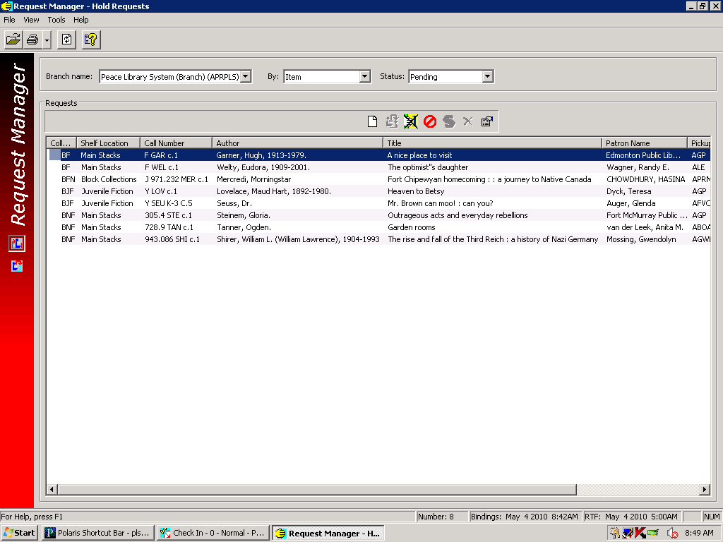
Identifying a VDX request in the Polaris request Manager
It is a VDX request, if the Patron Name is a library outside TRAC and the Pickup Branch is AGP, or if the Patron Name is a library and the pickup acronym does not match the Patron Name.
Grande Prairie Public Library (AGP) as the broker for PLS member libraries, will send these books to Edmonton or Fort McMurray. Send the item to Grande Prairie, and include a TAL flag. The VDX work queue is updated by AGP.

