Slide 1
Creating and Editing Item Records Part 2

Slide 2
Table of Contents for Part 2
Search tips (pages 3-15)
The “Karate Chop” – “Ctrl+Shift+A”
Secondary Sorting
“All Keyword Fields” searching
Editing item records (pages 16-26)
Entering item record “volume field” data for multiple–volume (multi-part) Bib records (p. 27-78)
Definitions and protocols
Magazines, serials, discs and other multiple volume Bib record examples
Quiz questions (pages 79-end)

Slide 3
Search Tips

Slide 4
The “Karate Chop” (Ctrl+Shift+A)
When searching in Polaris, there may be more results than can be shown in one window.
In the bottom right corner of the search window there may be a note saying, for example, “28 of 353 record(s) retrieved”.
14 results fit in a small window, but 28 are “retrieved” and sortable. [Click the square between the hyphen and the x in the top right corner, to maximize the window to see 28 or more at a time or to go restore to a small window.]
Try a Polaris search for Bibliographic Records with Archie in the title.

Slide 5
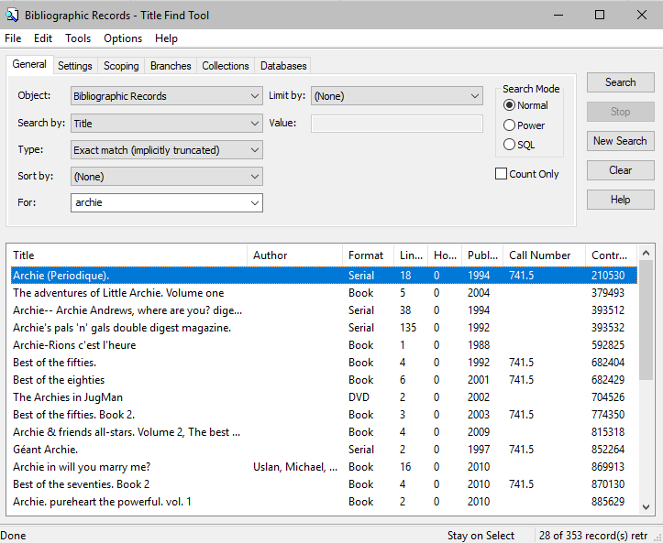
Bib Record Title Search for Archie
Click on any column heading to sort 28 records by title, author, format etc.
Use the scroller bar again and again and again and again…. to gradually retrieve all 353 found records or use a karate chop to instantly ‘retrieve’ them all!
Try this search in Polaris!

Slide 6
The “Karate Chop” = Ctrl+Shift+A
“Ctrl+Shift+A” is “nicknamed” the “karate chop”!
Leaving your cursor on the Find Tool window, click on “Ctrl+Shift+A” to retrieve all records for sorting.
The small window still only shows 14 of the 28 retrieved records (maximized shows more), but when the list is sorted, all 353 items will be included in the sort.
In the next slides are two screen shots comparing a “sort by title”, before a karate chop and a “sort by title” after a karate chop (searching for all Bibliographic records with Archie in the title).

Slide 7
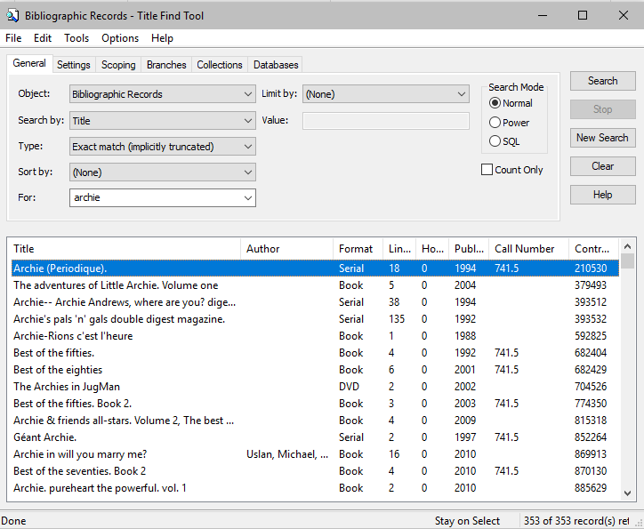
The “Karate Chop”
Before
28 of 353 items retrieved
353 of 353 items retrieved
After
When the search is “done” (as seen in the bottom right corner) 353 records were found (retrieved) to match the search criteria. 28 out of the 353 are shown.
(14 are visible in the window and 28 are sortable.)
In the second screen shot, all the records are retrieved with a karate chop (Ctrl+Shift+A). Although the list in the window appears the same, all 353 of the found records are retrieved. (No screen can display them all.)

Slide 8
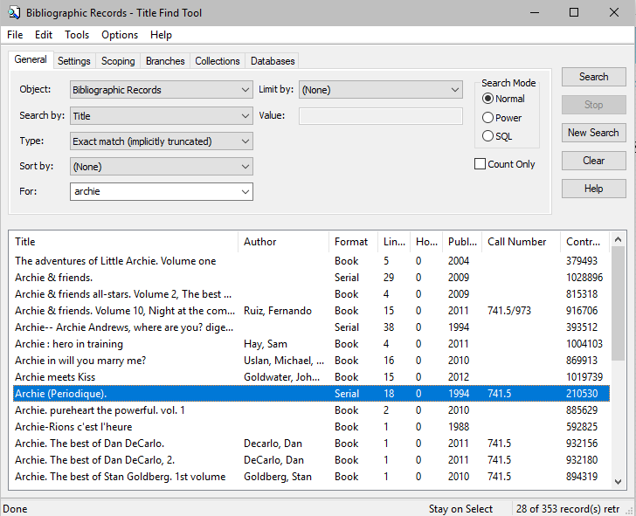
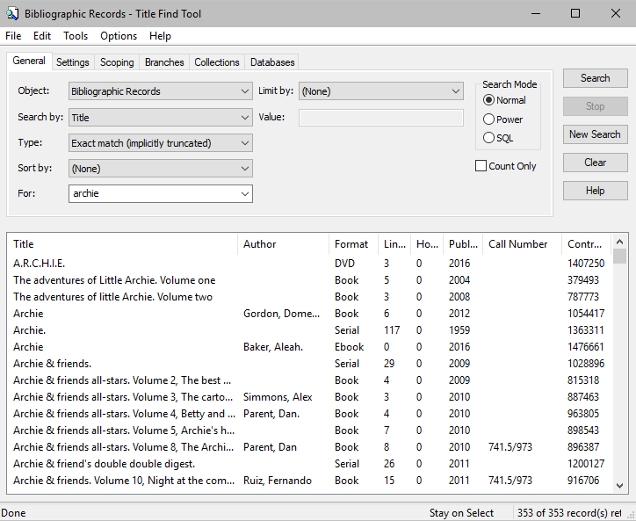
The “Karate Chop”
Before
28 retrieved out of 353 found
All 353 items retrieved
After
By clicking on a column heading once, 28 retrieved results are sorted alphabetically (a-z) (a second click on the same heading sorts from z-a). “Title” was clicked once in the first screen shot above.
Above, all the records are retrieved with a karate chop (Ctrl+Shift+A). Clicking on the Title column heading after the karate chop sorts all 353 records - a very different list of titles show in the second picture.

Slide 9
Multiple sort levels
In the previous example, “Title” was clicked once, to produce a sort of all the titles retrieved. This is like a primary sort in a spreadsheet, and if there are multiple identical titles, may not be a useful sort.
Choosing a second column to sort (i.e. Publishing date, format or author) before (or after) sorting by title, produces a “secondary sort”, which can be very useful!
Note: Clicking once on a column title sorts the list from a to z (or lowest number to highest). Clicking a second time on the same column title reverses the order (z to a or highest number to lowest). Clicking a third time on the same title, puts the order back to a to z (lowest # to highest).

Slide 10
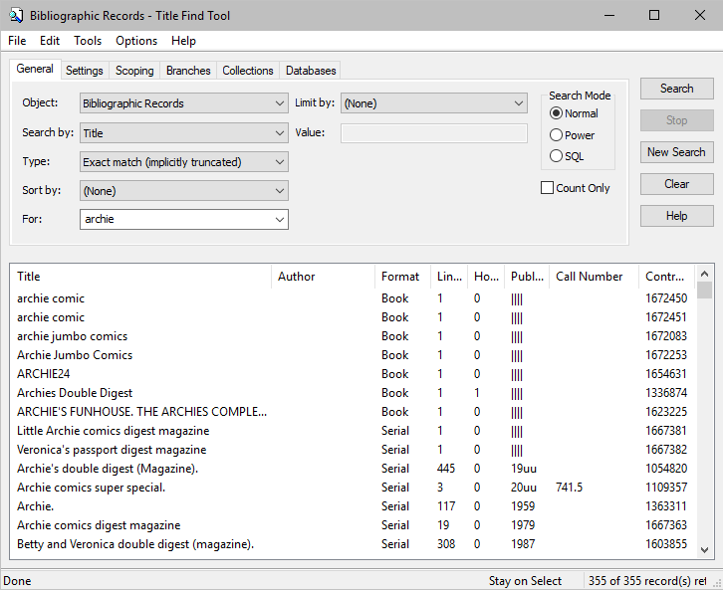
Primary sort
Secondary sort
1. Results after “Ctrl+Shift+A”, and then clicking on “Title” the heading in the first column, to obtain a primary sort by title.
2. Next, click on Publication Date to secondarily sort by date. Nine at the top of the list show no publication date information available from the Bib record. All the records with the same publication date are still in alphabetical order by title. The next slide shows the results after clicking a second time on Publication Date for a sort in reverse (newest at the top) retaining title order.

Slide 11
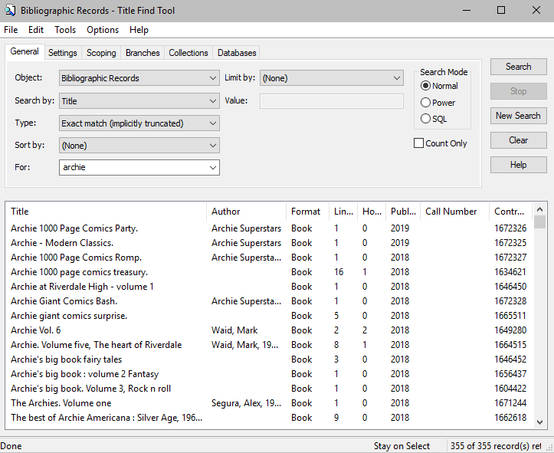
Starting with the newest Bib records is a faster way to find the right record to add your new magazine.
Remember from the first training module:
Examine the physical copy.
Check the Bib record.
Add the holding by creating a new item record.
Notice that two new records were added since the writing of this searching tip was started? The database is constantly in a state of flux as new records are added and old are removed!

Slide 12
“All keyword fields”
The “Search by” drop down menus in Bib record or Item record search tools contain lengthy field lists to help you narrow your search.
Searching by “All keyword fields” (at the top of the alphabetic list) is a very powerful way of pulling more results into your search.
Compare a Bib record “Title” search for the word “Legacy” with an “All keyword fields” search for the same. A “Title” search returns over three hundred results, but an “All keyword fields” search returns over three thousand!
After “Ctrl+Shift+A” to retrieve all records, click on format, then author. On the next slide see how all items by Nora Roberts are grouped by format!

Slide 13
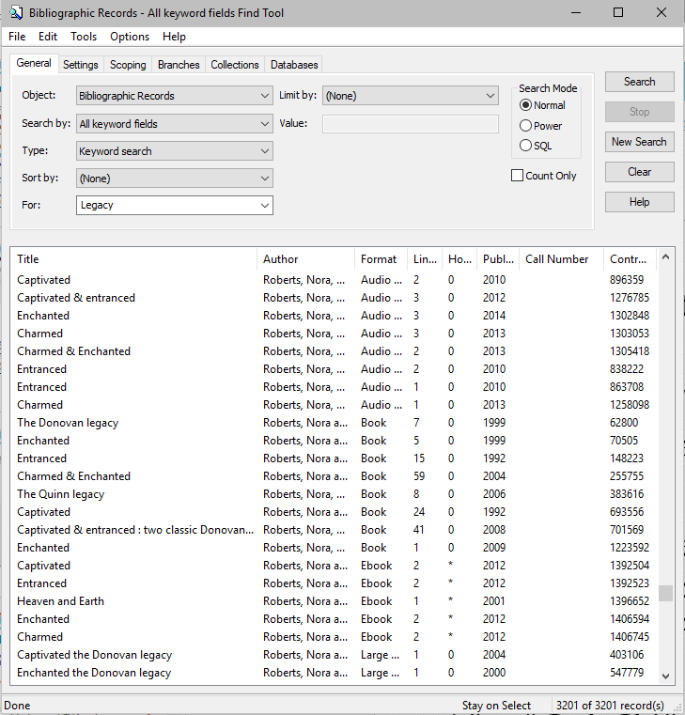
Search Bib records by “All keyword fields” for “Legacy”
Karate chop! (Ctrl+Shift+A)
Click on “Format”
Click on “Author”
Formats (i.e. books, audiobooks, etc.) by Nora Roberts (author)
are grouped together.
Eight of the 3201 Bib records are “books” by Nora Roberts.
“Legacy” will be found either in the title or in the Bib record somewhere!

Slide 14
Question…
In addition to this primary sort by author and secondary sort by format, can you also return a tertiary (3rd level) sort by year of publication, so the books within this sort are in order of publication date?

Slide 15
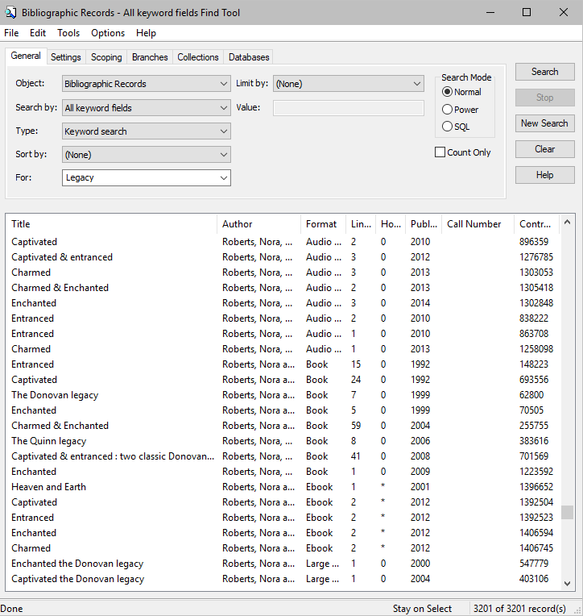
Answer: YES
Search Bib records by “All keyword fields” for “Legacy”
Karate chop! (Ctrl+Shift+A)
Click on “Publication Year”
Click on “Format”
Click on “Author”
Books (formats) by Nora Roberts (author)
are grouped together and sorted by date!
Have fun experimenting with “Find Tools”. The more practice you have, the better you will be at finding the Bib or item record you need!

Slide 16
Editing Item Records

Slide 17
Editing Item Records
Find and open the item record (usually by scanning a barcode into an Item Record Find Tool, or by checking the item in, and double clicking on the line to open it).
Change the field requiring correction…for example…
Change the collection code by clicking on the drop down arrow in that field and selecting another from the list.
Change the shelving location (if used by your library) by selecting another from the drop down list.
Correct the spine label by entering information into the correct call number fields. Follow formatting rules.
Link to another Bib record by entering another Bib Control Number in the top right area of the item record.
Replace a tattered barcode by highlighting the old barcode and overwriting it by scanning the new barcode.
Save your changes. Polaris will prompt you to save your changes when you close the record. Click “Ctrl + S” or the save icon.

Slide 18
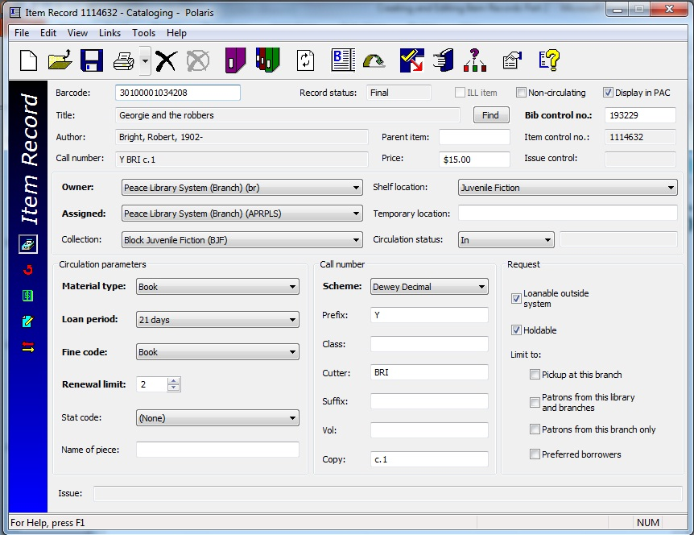
Editing Item Records-Example 1
“George and the robbers”, an older book, was found shelved in the juvenile section, but it should be with the picture books, and you intend to move it there…
Change the collection code.
Change the shelf location.
Change the call number prefix.
Save changes and print a new spine label.
Shelve in the correct section.
k
j
l

Slide 19
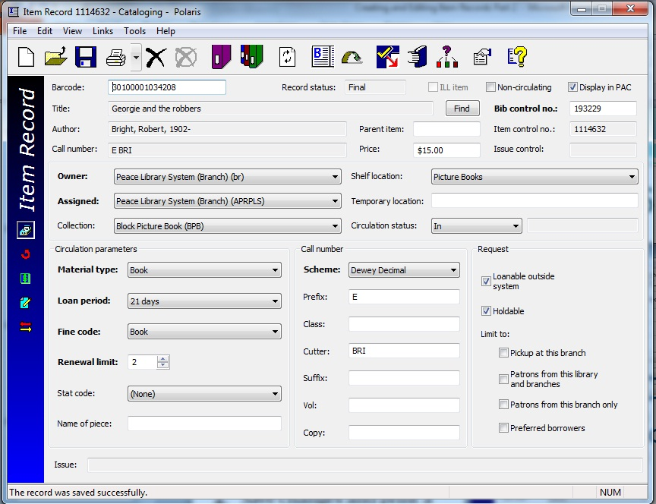
Editing Item Records-Example 1 cont’d.
Finished edits and saved!
Your consultant may be able to add new collection codes and shelf locations to the drop down menus.
Call or email headquarters!

Slide 20
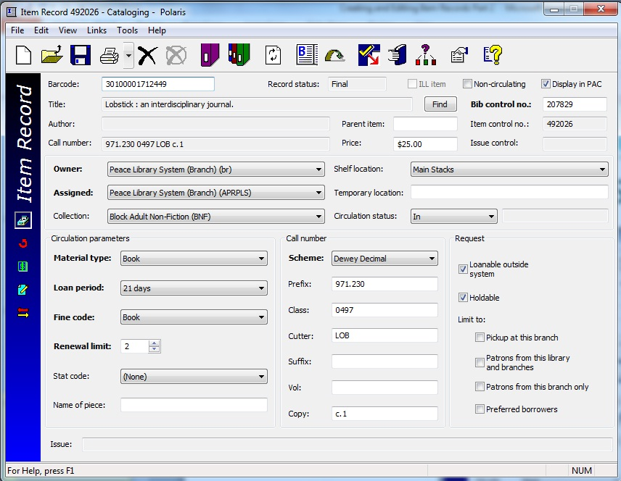
Changing the call number-Example 2
In this example, the first six digits of the classification number should NOT be in the prefix field-they should all be in the Class field!
Enter the complete classification number in the Class field, and leave the Prefix field blank.
Three digits after the period are usually sufficient, but more can be used.
If you split the call number by using a space or by putting some of the class number in the prefix field, your shelf list will not print in the correct order.
DO NOT LEAVE SPACES nor other non-numeric characters!

Slide 21
Changing the call number-Example 2 cont’d.
You may want to use just two of the “Class” digits after the period (971.23). Three numerals after the decimal point are normal practice.
Class field rules:
Use the format: xxx.xxx
NO alpha characters.
Classification numbers should never end in zero.
Use no period if using three digits only. (i.e. 971)
Do not use spaces or slashes, to keep reports in sequential order.

Slide 22
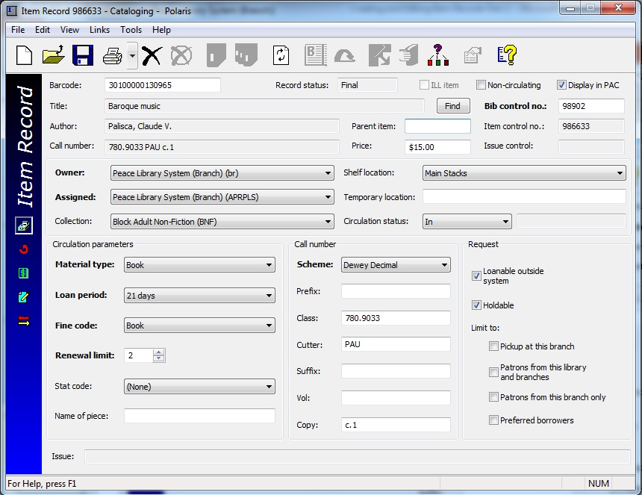
Editing Item Records-Example 3
What if, while doing inventory, you find a book whose title is wrong on the item record!
The item record for this barcode says Baroque Music, but the book in your hand is called “Music in the classic period”!!!
How can you change the title in an item record, when the field is grey (cannot be edited)?
Hint…….
This item record is linked (or attached) to the wrong Bib record!

Slide 23
Editing Item Records-Example 3 cont’d.
Think of each Bibliographic record as a solar system sun in the Polaris galaxy.
The planets circling the sun are the item records, and should be alike. The blue planet here is orbiting the wrong sun!
The Bib control number is found in the top right area of the item record. It shows the linked Bibliographic record by number. Title and author fields identify the Bib name.
P
P
Item record
Item record
P
Item record
Bib record
Item record
O
Item record
P

Slide 24
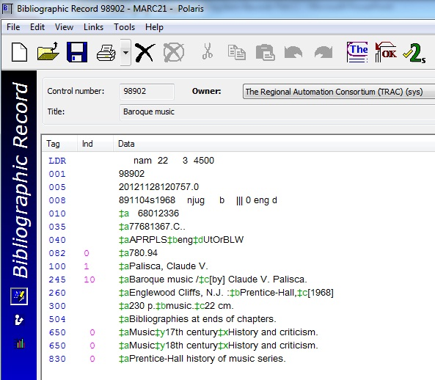
Editing Item Records-Example 3 cont’d.
O
O
This item record is in the wrong solar system, linked there by the Bib control number written in the item record! The real title on the book you are holding does not match the item record: it is not “Baroque music”, but “Music in the classical period”.

Slide 25
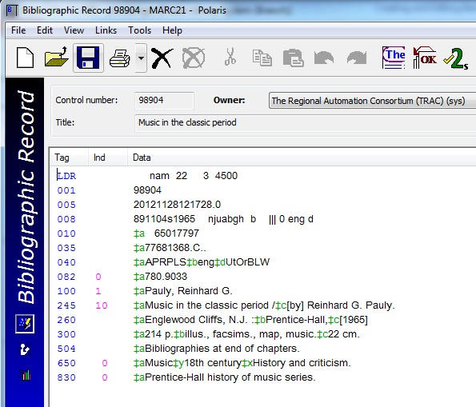
Editing Item Records-Example 3 cont’d.
O
O
P
P
Find the correct Bib record with a title search.
Enter the correct Bib control number (98904) in the item record, and save the change.

Slide 26
Editing Item Records-Example 3 cont’d.
Now the item record is in orbit around (linked to) the correct Bib record (control # 98904) and the item record title shows correctly!
P
P
P
P
Watch for typing errors – you could accidentally “correct” the name by linking to “CatfantasticV”! (Bib control # 98905). Avoid typos with “copy and paste”!

Slide 27
Item Record Volume Fields

Slide 28
Volume Field Basics
WHERE is the volume field? The Volume Field (Vol:) is found in the lower middle section of an item record in the “Call number” area as shown here:
WHY is it so important? Polaris uses contents of this field to change how hold requests are made, and so there are strict expectations for how the field is populated. The volume field is so sensitive that even a blank space will change how hold requests work.
HOW does it work?
Blank volume fields launch a one step hold process. When all items attached to a particular Bib record have blank volume fields, Polaris knows they are all the same, and any one of the items will satisfy the patron. Polaris selects one item from all the items attached to a Bibliographic record to satisfy the request and populate a request manager.
Populated volume fields initiate a two step process. When one or more items have volume field contents, Polaris recognizes that the items are not alike and patrons are asked to CHOOSE one kind of item (v.1 or v.2, etc.), by clicking on this icon beside each item. After making the choice for v.1 or v.2, Polaris selects from all the items with the same volume field, first confirming if the patron will accept the first available copy of that kind, or if the chosen item is the ONLY one that will satisfy.

Slide 29
Volume Field Functioning
The volume field is so sensitive that even a blank space will turn on the two-step hold function which can delay a hold or prevent a hold being filled correctly. If you are editing a volume field, be sure to backspace to the very left side of the field, before saving changes to the record, to insure you are not leaving a space. The human eye detects no difference between a blank volume field and one containing one or more spaces, but Polaris does!
Polaris thinks like a computer, so these entries are NOT the same:
v.1 / vol. 1 / v1 / v. 1 / VI. / VI
It is very important to be particular about the use of spaces, punctuation, format and syntax, in order that Polaris can identify like and unlike items attached to the same Bib. There are strict rules maintained across all four systems in TRAC for volume field use and composition - there is no room for ‘creativity’ here!

Slide 30
Volume Field Essentials
Entries in the volume field indicate:
the volume number of a multiple volume publication or
a disc number of a multiple disk set or
a part number of a multiple part release or
a certain issue date of a monthly publication, etc.
Two or more unique items are attached to one Bib record.
(v.1 & v.2 OR DISC1 & DISC2 & DISC4 OR
JUN2018 & JUL2018 OR 234 & 236 & 252 )
To decide whether or not to enter information in this field the first question to ask is: Are many different items properly attached to one Bibliographic record?
If the answer is yes, follow approved TRAC standards for volume field entries, as shown on the next slides. If the answer is no, leave the field blank: no characters of any kind and no spaces.
If uncertain, please send the item to headquarters for cataloguing, or phone for help.

Slide 31
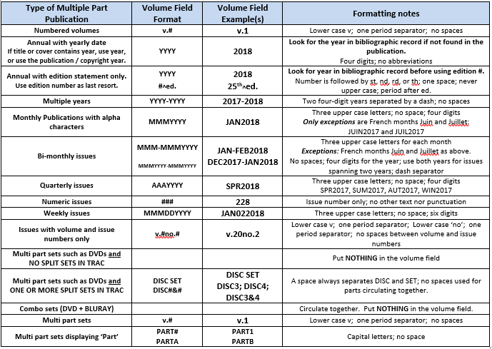
When to use the volume field
If different items are attached to the same Bib record, the next question is “What sort of a multiple-volume or multiple-part publication is it?”
The answer will determine the proper volume field format.
Formatting standards are outlined in the “TRAC Multi-part Manual”, and summarized in the following chart (shown full screen on the next slide). Keep a printed copy of the full sized chart for quick reference.
The first column lists all the different types of multiple part publications.
The second column shows the correct format for volume field entries.
The third column contains examples of correct volume field entries.
The forth column contains explanatory notes.

Slide 32
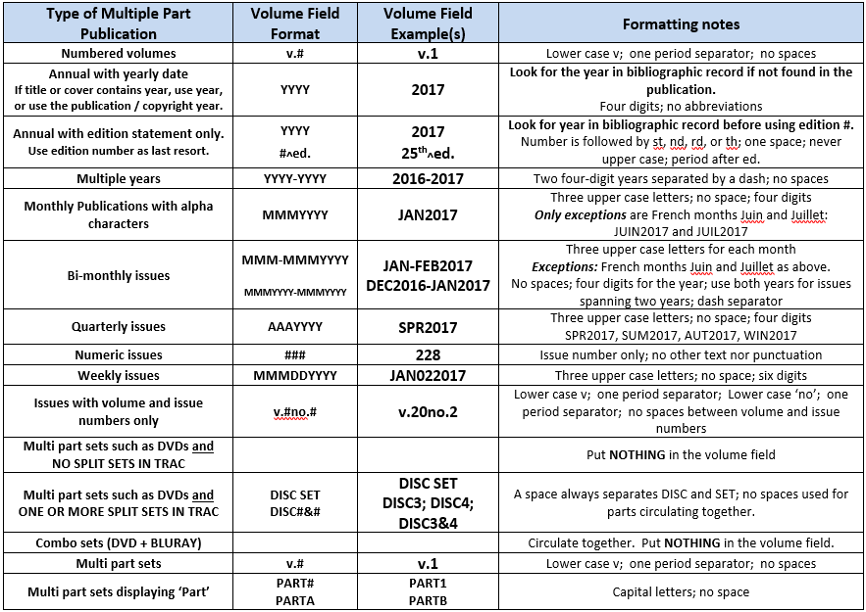

Slide 33
Keeping volume field entries standardized
Every week there is a scan of the entire database of item records in TRAC and 4 reports are created of all the items newly added, with volume field content. These are examined by each of the four systems for errors.
Errors may be corrected by headquarters, for which you will be notified, or you may be asked via email to correct an error.
Unfortunately there is no way to identify records that were added and should have had a volume field entry made, but did not.
Because we share an enormous database, the decision to add or not to add something to the volume field must take into consideration what others have done. With volume fields, it must be everyone makes an entry or no one does. Everyone remains blank, or everyone requires volume entry.
Please call the office if you have to clarify whether or not to add something to your volume field.

Slide 34
The following slides will focus line-by-line on the chart starting with “Numbered Volumes”, then “Annual with Yearly Date”, and so on...
Please pay particular attention to the following formatting details:
Lower case vs. upper case. If the chart calls for lower case, use lower case, and vice versa. No substitutions are allowed!
Spaces vs. no spaces. If a space is used in the example, use a space…
Hyphen (dash) vs. backslash. Please do not substitute!
If a sequence of 6 characters is required, use 6 characters!
WHY? These formatting standards must be followed so that computers know one thing is like (or not like) another.
Remember, to a computer v.1 and V. I are not the same!

Slide 35
Numbered Volumes
Numbered volumes are publications that contain multiple volumes often published in the same year.
One Bib record will have all the different volumes, or item records attached.
Each volume may have its own ISBN, so the Bib record may have many ISBNs added by the TRAC cataloguers.
If you search by ISBN and don’t find a correct Bib record, please send to headquarters.
Four different items (v.1, v.2, v.3 & v.4) on one Bib at many locations.

Slide 36
Numbered Volumes
Bib record 536217 describes volumes one, two, three and four of “Place names of Alberta”.
Check tag 300 of the Bib record. The “a” subfield says “4 v.” and does not indicate the number of pages, as the description field does for single volume books. This means the book is printed in four separate bindings.
Click on the Linked Item Records icon at the top of the record to open the linked item record list. Note that in this example, some volume field data is incorrect, and some is missing.
Try placing a hold on this record!
Four different items (v.1, v.2, v.3 & v.4) on one Bib at many locations.

Slide 37
Numbered Volumes
One library is circulating all four volumes together, so when a patron wants to borrow all four, they would chose the record with v.1-4 in the volume field (or place four separate holds on individual volumes. The first available copy of each one would then be selected by Polaris to satisfy the hold.
If a patron wanted to borrow volume three only, it looks like only two of the items would satisfy.
The blank volume fields are mysteries to the patron and to Polaris, and cannot satisfy holds requests.
One copy has v.2 in the call number, but Polaris needs that in the volume field to properly manage hold requests.
Four different items (v.1, v.2, v.3 & v.4) on one Bib at many locations.

Slide 38
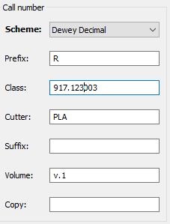
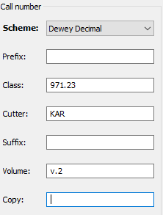
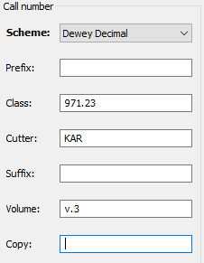
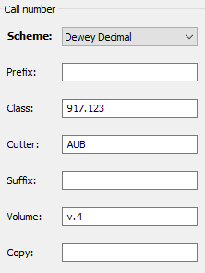
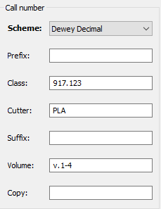
Numbered Volumes
The correct format is v.1, v.2, v.3, v.4 or v.1-4 for the volume fields in these item records:
lowercase v followed by a period followed by a number (or range of numbers) with NO spaces.
If you have two copies of one volume, also use c.1 and c.2 in the copy fields.
If you put “Vol.1” or “vol1” or v. 1” in your Volume field, the computer cannot tell that it is the same volume as the correct example on the far left.
Accuracy is critical!
Note that each call number shows the distinctive library procedures: the use of or not used (blank) prefix field and cutter variations. But volume field formatting is standard for all TRAC libraries.
Always look at other holdings.
If one library uses the volume field, all libraries must.

Slide 39
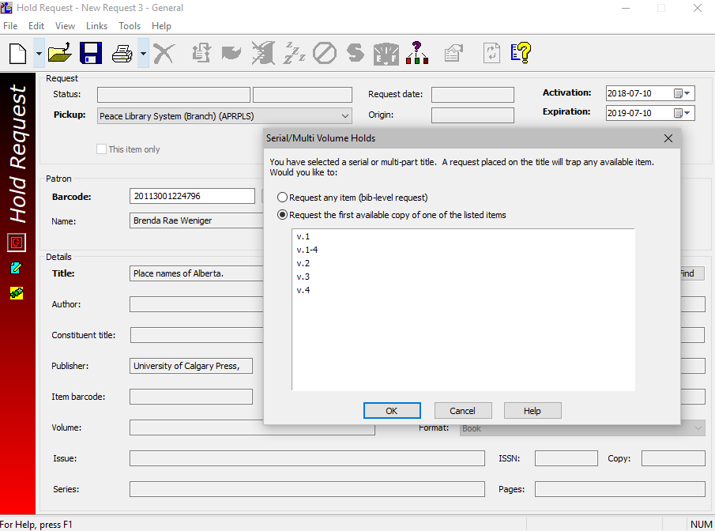
Numbered Volumes
When volume fields are used, this screen is presented to the patron or library staff placing the request. If the first is selected (request any item), there is no telling which volume will arrive. If the four volume set is wanted, Polaris compares all the volume fields, discovers only one, and completes the workform with the appropriate information: If the third volume is wanted, Polaris enters v.3 in the workform and the first available copy of v.3 will be offered.

Slide 40
Annuals with Yearly Date
An example of this kind of publication is “Guinness World Records”.
If you are the first library to purchase the new edition, an ISBN scan will produce no results. Cataloguers at headquarters will need to add the new ISBN number to the Bib record. Please send your item to headquarters.
Usually for this kind of publication we read the Bib record and use the publication date associated with the ISBN in question.
When the year is not printed in the title or on the cover, read the Bib record and use the publication date associated with the ISBN on your book.
IF the year is on the cover or in the title, use that year, regardless of publication or copyright date.

Slide 41
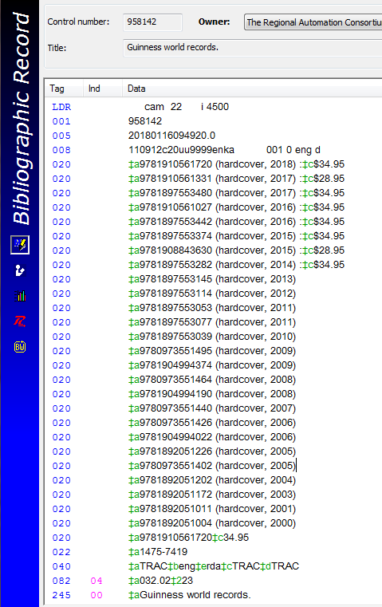
Annuals with Yearly Date
Are many different items linked to the same Bib? YES – many ISBNs
Is this an “Annual with Yearly Date” (not spanning 2 years)? YES
What was the copyright date found inside the book, and on the cover? 2018
Conclusion:
Enter 2018 in the Vol. field!
First choice: Title date
No title date? Use the copyright date from inside.

Slide 42
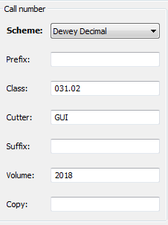
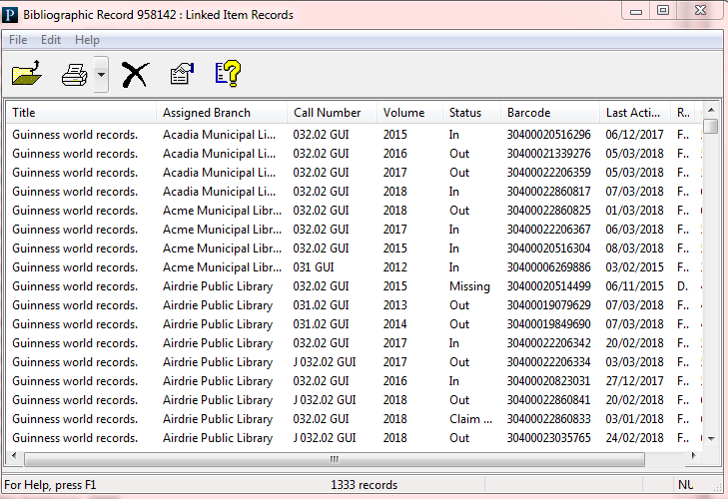
Annuals with Yearly Date
Many different items (different years) linked to one Bib record.
Do not put a space before or after the date.
To Polaris “<space>2018” is not the same as “2018”.

Slide 43
Annuals with Edition Statement only
It is rare to find a published item with only an edition statement, and no copyright date.
Note that the preferred format is the same for the previous type of publication, and the edition number is only to be used if no copyright date can be found on the item, or in the Bib record.
Use copyright date, if available, regardless of the edition number in the title. Check the Bib record!

Slide 44
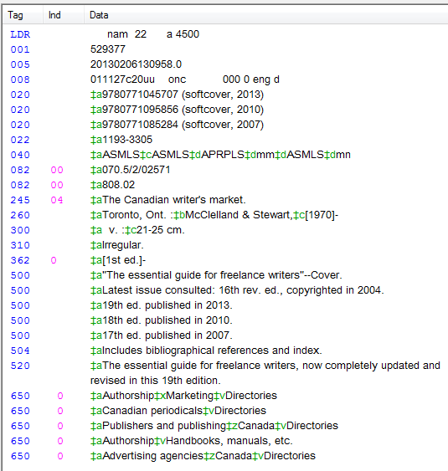
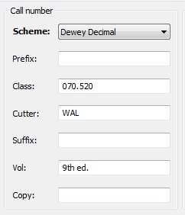
Annuals with Edition Statement only
Are many different items linked to the same Bib? YES
What does the 300 tag say? v.
The 9th edition has no copyright date so 9th ed. is correct.
What should the volume field say for the 19th edition (printed on the cover)? Hint: Read the 500 tags…
Answer……..

Slide 45
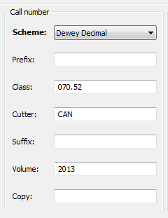
Annuals with Edition Statement only
Answer: 2013
Although the edition number is written on the cover, the standard for Volume Field entry is the year, found in the Bib record.

Slide 46
Multiple Years in one issue
Next on the Volume field data chart are “Multiple year” publications.
These publications cover more than one year in one book.
The format for volume field: the beginning and ending years separated by a hyphen.
No spaces:
YYYY-YYYY
2016-2017

Slide 47
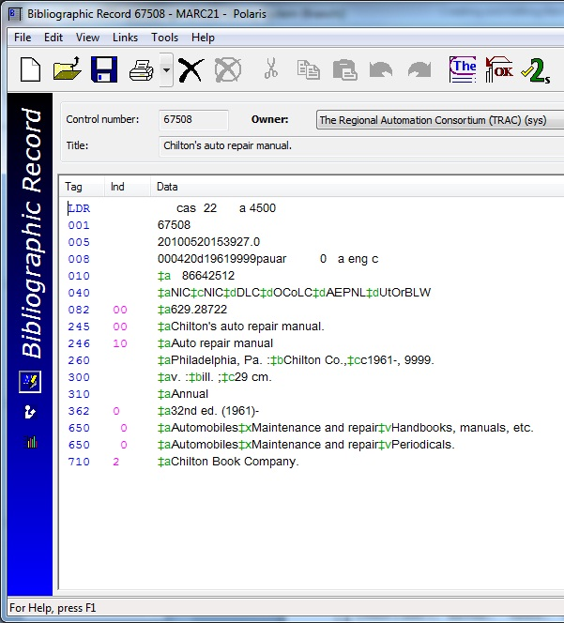
Multiple Years in one issue
In this example, the 300 tag suggests that this is a candidate for entering information in the volume field, but there are no ISBNs listed to confirm!
Check the list of attached item records to see if there are different items attached to the same Bib record.

Slide 48
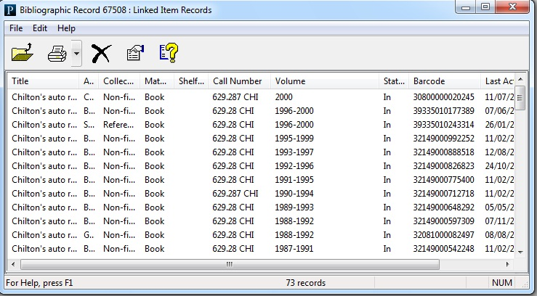
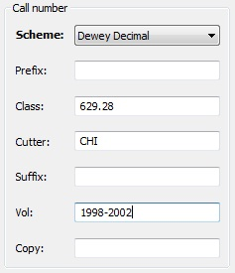
Multiple Years in one issue
YES!
Many years (many different items) are linked to this Bib record.
In the volume field of your new item record, enter the first and last year separated by a dash.
NO SPACES!

Slide 49
Monthly publications
Vogue magazine is an example of a monthly publication.
Many issues are attached to one Bib record. In the following slides note some interesting details…
The Bib record identifies the magazine as a serial.
The description tag (300) has no pagination (v. only).
Call numbers vary between libraries but volume fields must be standard.

Slide 50
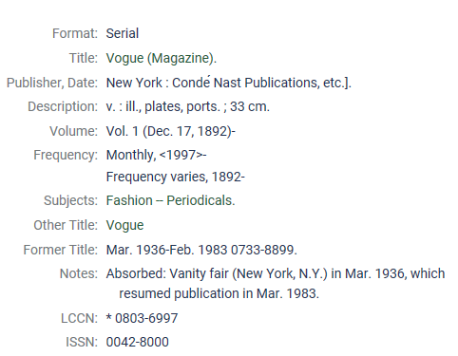
Monthly publications
March 2018 cover
Note: This Bib record is shown in the TRACpac (patron’s) view.

Slide 51
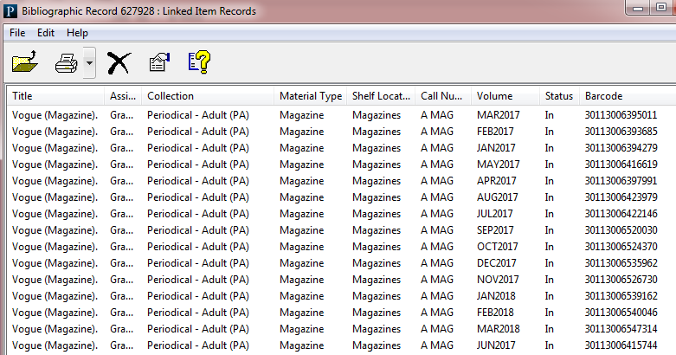
Monthly publications
Many different issues on one Bib record.
Note the consistent volume field format: Three alpha characters followed immediately by four numeric characters - no space, no hyphen, no backslash. Even September, often abbreviated with four alpha characters (SEPT), is shown with three letters only: SEP.
Exceptions are two French months: JUIN & JUIL, indistinguishable without that fourth letter!

Slide 52
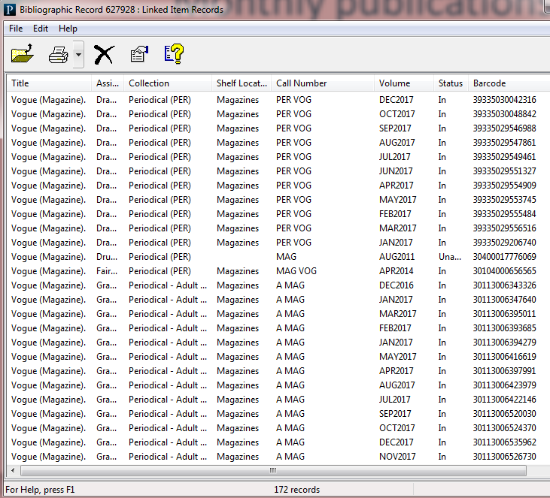
Monthly publications
Note the different call number standards from library to library, in the prefix, the cutter, or the suffix fields.
But never in the volume field - volume standards are TRAC-wide!

Slide 53
Bimonthly publications
Some serials are published six times a year, or bimonthly.
Format is always the first month and second month separated by a hyphen, immediately followed by the year. NO SPACES
If the issue scans two years, both years are used.

Slide 54
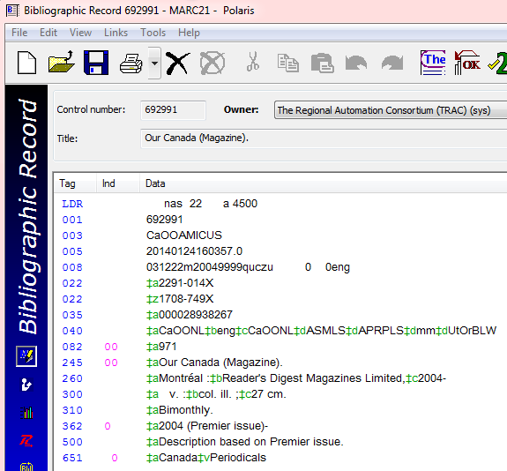
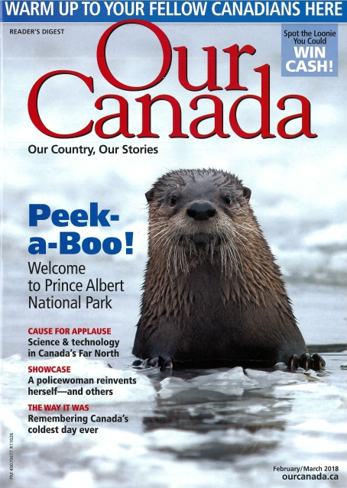
Bimonthly publications
Bib record details show that many different bimonthly issues will be linked to this one Bib record.

Slide 55
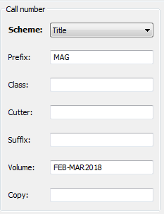
Bimonthly publications
Do not use the format on the cover of the magazine – use the volume field chart to ensure correct formatting.
February/March 2018
is written on the cover

Slide 56
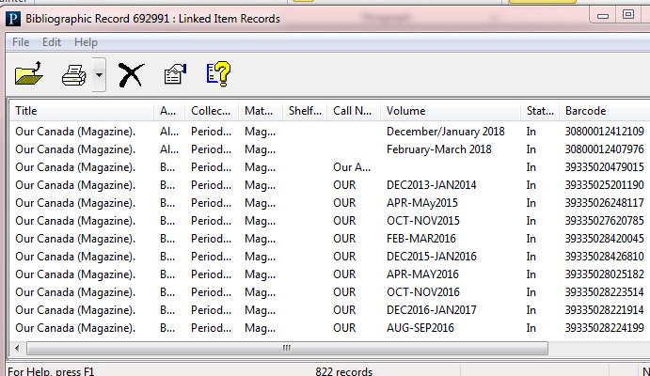
Bimonthly publications
1. & 2.
3.
4.
Examples of incorrect entries
Forward slash is not correct. Use a hyphen.
Lower case alpha characters are incorrect. Use upper case 3 character abbreviations for the month.
Blank volume field is incorrect.
“MAY” should be all uppercase. (“MAy” is incorrect.)

Slide 57
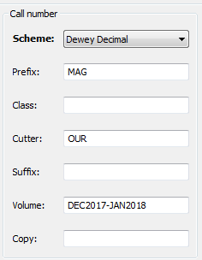
Bimonthly issues – spanning year end
This issue of the same magazine will be December of one year and January of the next. The correct format for this Volume field:
DEC2017-JAN2018

Slide 58
Quarterly publications
Often serials are published four times a year, or quarterly.
The correct volume field format is always the first three letters of the season, capitalized, followed by the year. NO SPACES
Seasons are named:
Spring (SPR)
Summer (SUM)
Autumn (AUT) or Fall (FAL)
Winter (WIN)

Slide 59
Magazine exceptions
Often quarterly publications, and others, have special issues in addition to their regularly released issues. It is not possible to list all the examples of these issues and their volume field requirements. Generally speaking, however, these are the guidelines to follow in hopes that these special editions look alike to Polaris:
Use all CAPS.
Use no spaces.
Include the year.
Only abbreviate months or seasons.
Avoid using words like “collectors”, “edition”, “issue”, “special” or “supplement” which are redundant in the volume field.
“FISHING2018” is preferable to FISHINGISSUE2018 or FISHINGSPECIAL2018.
“ANNIVERSARY2018” is better than “ANNIVERSARYCOLLECTORSEDITION2018”.
“PRUNING2018” is better than ‘”SPRINGPRUNINGSUPPLEMENT2018”.
Keep it simple!
Check other holdings, or call PLS headquarters.

Slide 60
Numeric publications
These serials are very simple for volume data, enter the number only. No text or symbols are required.

Slide 61
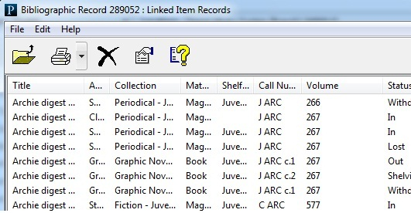
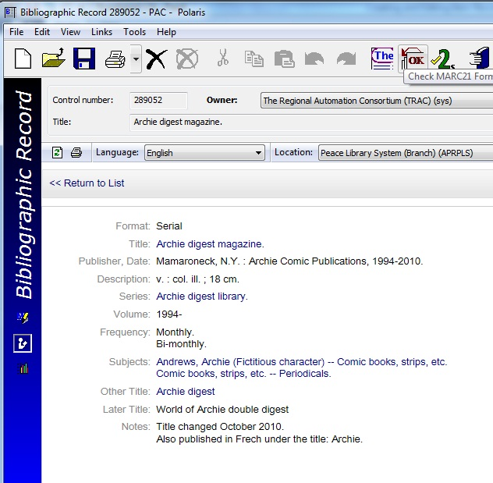
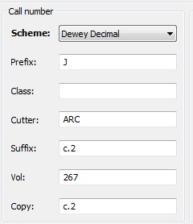
Numeric publications
Many issues , one Bib record.
In the linked item list the “copy number”
data (c.2) is retrieved from the suffix field entry.

Slide 62
Weekly publications
Use three upper case alpha characters for the month;
followed immediately (no space) by two numeric characters for the day (02, 04, 07, 17, 21…);
then four more for the year (no space).
Some serials have a weekly publication timetable.
Use no spaces, use two numbers for the day then four for the year.
Use no punctuation marks, use all CAPS.

Slide 63
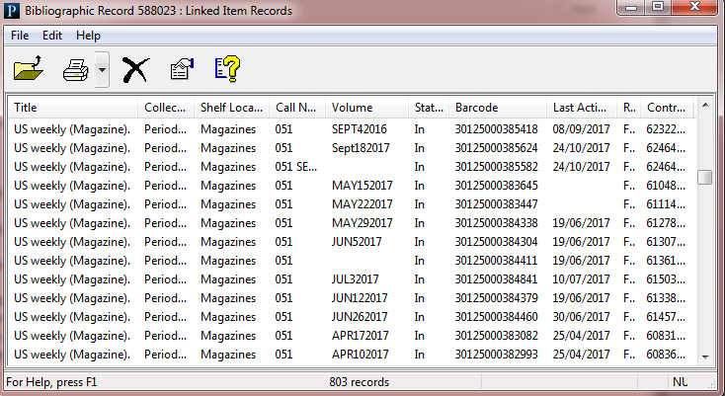
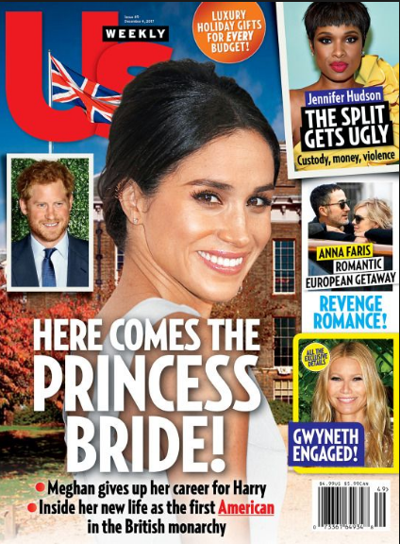
Weekly publications
Many of the volume fields are incorrect in the above example!
Can you find the mistakes? Can you tell how to correct them?

Slide 64
Weekly publications
Change SEPT to SEP;
Change Sept to SEP;
Fill in the blanks;
Change 5 to 05 and
3 to 03!

Slide 65
Volume and Issue Numbers Only
Some publications have volume and issue information. Usually one volume number is assigned to each issue published in a certain year, and then each issue published within the year has a unique identifier number.

Slide 66
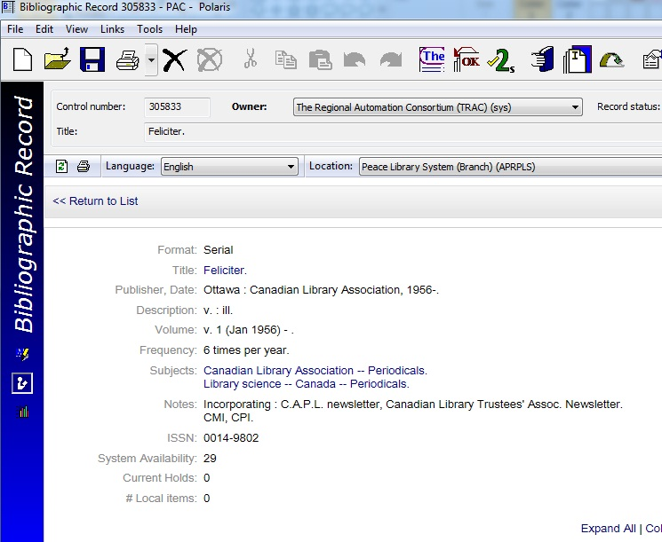
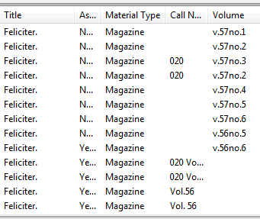
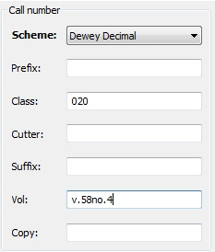
Volume and Issue Numbers Only
Many issues, one Bib record.
And here the last four have NO volume field information!

Slide 67
Multipart sets - DVDs
A “season” of DVDs in one case is an example of a multipart set. Each DVD in the set is different, but all the parts, or discs together form the whole season.
If one of the TRAC libraries chooses to circulate each disc of a season singly, or in sets of two or three, all TRAC libraries must fill in the volume field with information appropriate to how they are circulating their discs, because the volume field is what differentiates one disc from another for the borrowing patron in our shared collection.
If one library uses the volume field, then all libraries require volume field information.
The chart shows the proper format for volume field for what is barcoded together, as a set (with one barcode), or barcoded separately (different barcode for each disc or group of discs).

Slide 68
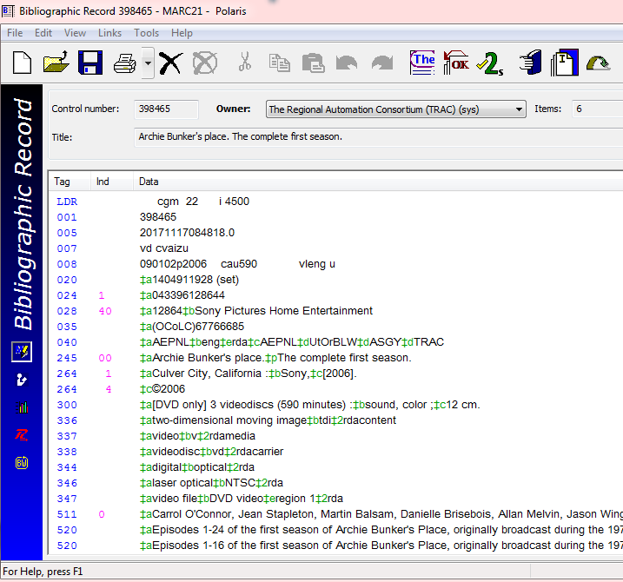
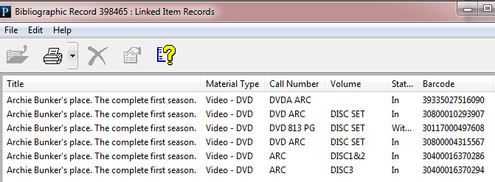
Multipart sets - DVDs
There are six items linked to this Bib.
Click on the downward swooping arrow to see the list.
The first record is incorrect.
The Volume field should say “DISC SET”.

Slide 69
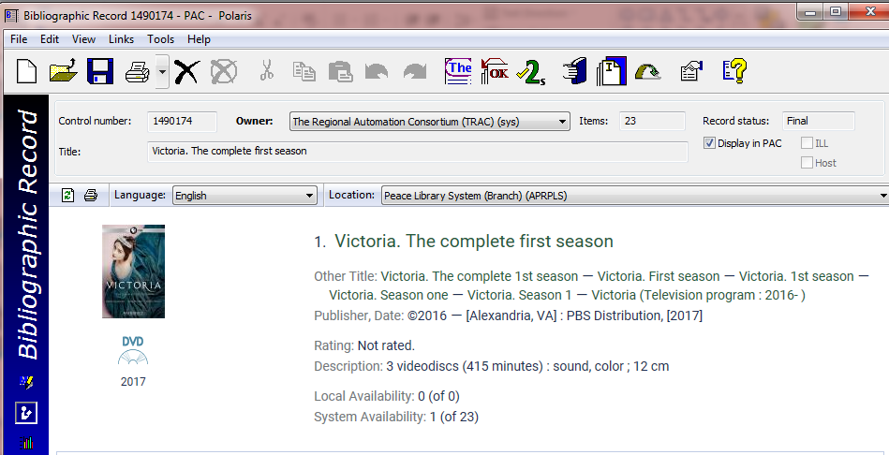
Multipart sets - DVDs
There are 23 items linked to this Bib.
Click on the downward swooping arrow to see the list.
Format icon
The volume field of each record is blank.

Slide 70
Multipart sets - DVDs
Many circulation options! 15 libraries are circulating “Stargate SG-1” as a set. Some are circulating as individual discs and some with 2 discs in one package. How many copies of the fifth disc only are circulating? Four.

Slide 71
Multipart sets - DVDs
One item record, one barcode, one “DISC SET”. Use DISC SET in the volume field IF another library is using DISC SET or DISC#.
If discs 3 & 4 are lost…
You can still circulate discs 1, 2 & 5! Two item records, two barcodes!
If one or more items attached to the same Bib record have something in the volume field, all items must have.

Slide 72
Combo-packs – Blu-ray + DVD
The Blu-ray and DVD discs must stay together and circulate together.
NO volume field entry is required.

Slide 73
Combo-packs – Blu-ray + DVD
If a Combo Pack has already been split into one Blue-ray record and one DVD record, and no third record for both items exists, please send the Combo-pack in for cataloguing.

Slide 74
Combo-packs – Blu-ray + DVD
Make no entry in the volume field.
In the “Notes and Notices” view, enter details about your holding in the public note field so it displays in TRACpac and in the free text field so it pops up at check out.

Slide 75
Multi-part sets

Slide 76
Multi-part sets
In this example, Volume 2 comes in two parts.
The volume number is in the title, so not used in the volume field, and “Part” is used to distinguish between them. Optionally, volume number can be entered in the suffix field.

Slide 77
Appendix -When NOT to use the volume field -Magazine cheat sheet Please advance to slide 85, if you feel you are ready to begin the second quiz. Review this section for detailed explanations if you have trouble understanding when to leave the volume field blank.

Slide 78
When NOT to use the Volume Field
For series books like Harry Potter, each individual title in the series will have it’s own Bib record.
The item records that are linked to that Bib record should NOT contain any volume information.
If one or more of the linked item records has data in the volume field, the patron will be incorrectly prompted to choose a specific volume.

Slide 79
When NOT to use the Volume Field – continued
….etc.
This series of books is catalogued on separate Bib records and items do not require volume field data. Other examples are The Twilight series, the Hardy Boys, Rainbow Magic Fairies, Manga graphic novels, Magic puppies, Pony scouts….
The books may have a 1 or a 4 or a 6 on the cover to identify them as a part of a series, but they DO NOT require volume field data. Put the number in the suffix field if you want it to be a part of the call number, but NEVER in the volume field!
These books are NOT attached to one Bib record.
They are each linked to a different Bib record.
NO volume field data.

Slide 80
When NOT to use the Volume Field – continued
This is the first book in a series. It is tempting to put volume data in the volume field because the number one is printed on the cover and “Volume 1” is printed at the head of the “Table of Contents”.
BUT – ask the question…
“Are different volumes attached to the same Bib Record?” (Will all 15 volumes in the series be on the same Bib?)…NO! Therefore the Volume field remains blank.
Check the Bib record for confirmation… (next slide)

Slide 81
When NOT to use the Volume Field – continued
Read the “a” subfield of the 300 (description) tag of the Bib record. If the Bib record has the number of pages noted here, the volume field should be left blank. If it has volume notation (“v.”) the volume field may require volume data.
Question: Is the “a” subfield:
a pagination statement?
a volume statement?
Answer: “192 pages”, therefore the volume field of the item record stays BLANK.
Put the series number in the suffix field if you want it to be a part of the call number.
Volume 2 of this series will have its own Bib record.

Slide 82
When NOT to use the Volume Field – continued
Some books have no page numbers and the 300 tag line contains a “v. statement”:
“1 v. (unpaged)”.
This means that there are no page numbers printed on the book.
Other counting books by Jennifer Adams will have their own Bib records.
NO volume field data is required.

Slide 83
Volume Field Decision Making
Do not rely on numbers in the title or on the cover.
Look at other item records attached to the same Bib – are other libraries using volume fields….BUT be cautious of others errors!
Read the Bib record paying special attention to:
The 300 tag (description tag). If the Bib record is full and complete, and there are no page numbers indicated, volume field data could be required.
If you still are uncertain, phone PLS headquarters or send the item in for cataloguing.

Slide 85
Quiz

Slide 86
Search in Polaris for the answers to this short quiz…
You want to circulate Season 2 of a television series
(5 videodiscs) with all the pieces in one case.
Another library is circulating all the episodes in separate cases. What information would you enter into the volume field of your item record?
What would you enter in the volume field if all the other libraries were circulating the season as a set in one case?

Slide 87
Search in Polaris for the answers to this short quiz…
2. You have received a donation of volumes 1-4 of The Junior Encyclopedia of Canada (Bib control # 271779). How many item records would you create to link all four items to the Bib record? List the volume information for the item record(s) you create.

Slide 88
Search in Polaris for the answers to this short quiz…
3. Decide the correct volume information for “Guinness Book of World Records, 2018”, published in 2017.

Slide 89
Search in Polaris for the answers to this short quiz…
4. Decide the correct volume information for “Hockey Superstars 2017-2018”, Bib Control #113072.

Slide 90
Search in Polaris for the answers to this short quiz…
5. You purchased the Blu-ray/DVD combo pack: “Snow White and the Seven Dwarves” (Bib control number 1393670). How do you proceed, in terms of Volume field content?

Slide 91
Search in Polaris for the answers to this short quiz…
6. You purchase a subscription to “Heritage Farm” (formerly Rural Roots magazine), and receive the your first issue (Spring, 2018). Which Bib record number do you use to create an item record for this issue, and what volume field data do you enter?

Slide 92
Search in Polaris for the answers to this short quiz…
7. You are adding an item record to Bib # 877349, do you need to enter volume information in the volume field, and if so what will you enter?

Slide 93
Search in Polaris for the answers to this short quiz…
8. You are adding the June, 2018 issue of Clean Eating (magazine) to your library. What is the correct volume information?

Slide 94
Search in Polaris for the answers to this short quiz…
9. You received a donation of a two-volume set, that has a good Bib record, on the covers of which is entered, not volumes 1 & 2, but parts 1 & 2. What will be the volume field information to circulate the items separately?

Slide 95
Search in Polaris for the answers to this short quiz…
10. What is the correct volume field information for an item you are attaching to Bib record # 397274?
Volume field should be empty
v.2
VOL2
V.II

Slide 96
Search in Polaris for the answers to this short quiz…
11. For People (magazine) published October 8, 2018, what should be entered in the volume field?

Slide 97
Search in Polaris for the answers to this short quiz…
12. You have DVD cases in stock that will hold 2 DVDs. A five disc set has just come back with the case broken. How will you circulate the discs now? Include volume information in your answer.

Slide 98
Search in Polaris for the answers to this short quiz…
13. You purchased Season 1 of “The crown” and want to circulate each of the four discs separately. What volume field entries do you use?

Slide 99
Search in Polaris for the answers to this short quiz…
14. What volume field entry do you create for your new issue of Our Canada(magazine) Issue: December 2018-January 2019?

Slide 100
Search in Polaris for the answers to this short quiz…
15. You are adding a travel guide to your collection: The Lonely Planet guide to Hawaii, 12th edition. What goes in the volume field? Review “All keyword searching” to find the record!

