Slide 1
Creating and Editing Item Records Part 1

Slide 2
Part One - Overview
What is an Item Record? (page 4)
What is a Bibliographic Record? (page 16)
Searching for a Bibliographic Record (page 24)
Creating an Item record (page 32)
Review the Three Step Process (page 59)
Quiz (page 71)
The 2017 revision of this presentation was made with Polaris 5.2 screen shots.

Slide 3
What is an Item Record?

Slide 4
What is an item record?
An item record contains specific information about one of the books, (or magazines, audio books etc.) in your library.
Two or more libraries may have the same book, (or magazine, audio book etc.), but the item record for each will be unique.
Between libraries, call number protocols differ, lending periods differ, shelving locations differ as well as fine codes, renewal limits, circulation status and other library specific facts about the books, (or audio books etc.).
Each item record has two unique indicators – the barcode, (assigned by the library, or the system headquarters) and the item record control number (created by Polaris).

Slide 5
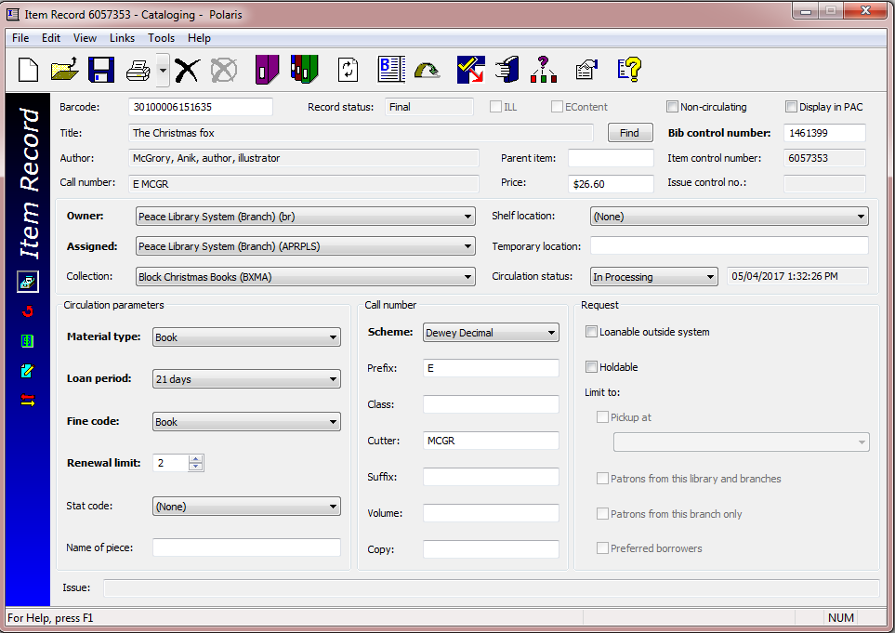
This is an item record

Slide 6
Item record – cataloguing view
In the top area of the item record, some fields can be edited or changed. These have a white background, like barcode or price, OR have a drop down menu arrow, like owner or shelf location.
Cataloguing view
Circulation view
Source and acquisitions view
Notes and notices view
History view
The icons on the blue banner on the left provide different “views” of the item record.
This first (default) view is the cataloguing view.

Slide 7
Item record – cataloguing view
In the top area of the item record, some fields cannot be edited or changed. These have a grey background, like title, or author. These details come from a Bibliographic record. In this case, the Bibliographic record with control number 1461399. The Call number (grey background) reflects what is entered in the fields below (with white backgrounds).
Cataloguing view
-Circulation parameters
-Material type
-Loan Period
-Fine Code
-Renewal Limits
-Call number parts – entries here are reflected in the top area of the workform.
-Request parameters
Clicking on the left banner icons changes the bottom half of the work form, as seen in the next slides.

Slide 8
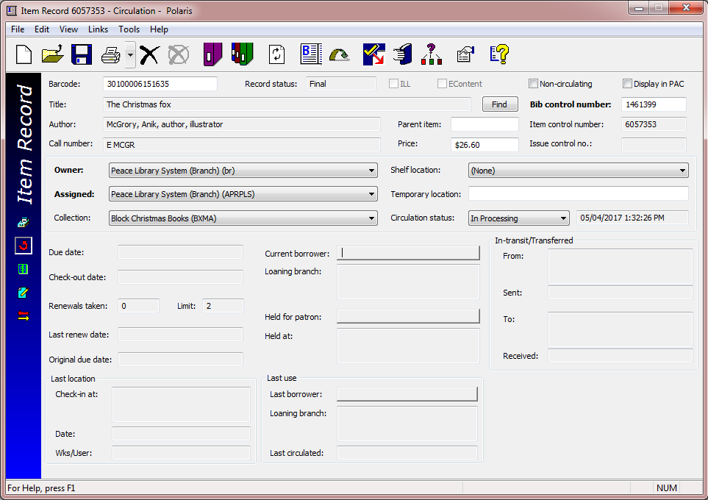
Item record – circulation view
-Due Date
-Check-out date
-Renewals
-Patron number
-Last borrower
….and more!
These fields will be populated once the item starts to circulate.

Slide 9
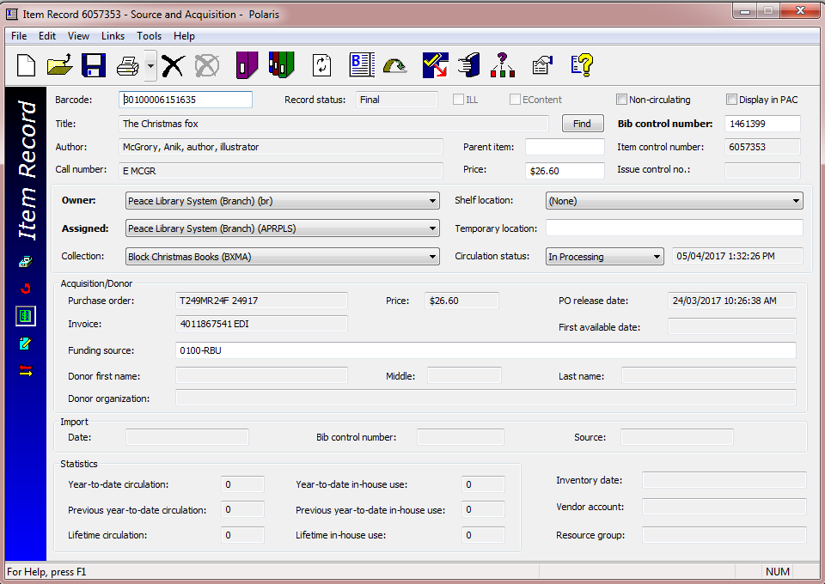
Item record – source & acquisitions view
Many of these fields are auto-populated by purchase orders and invoices created in the PLS acquisitions department.
Statistics will accumulate as the item circulates.

Slide 10
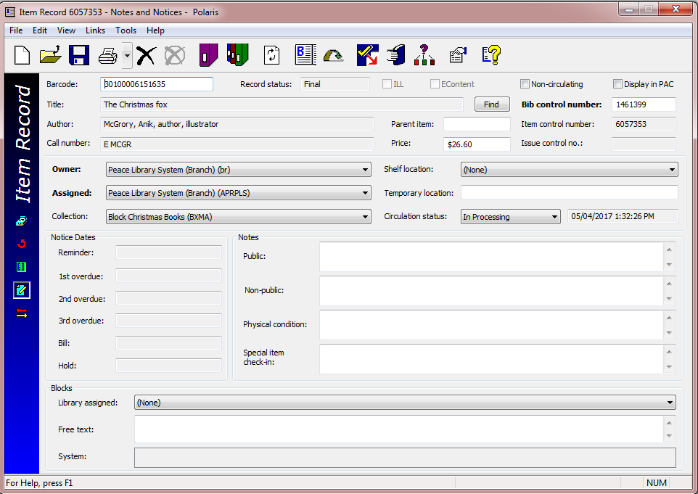
Item record – notes and notices view
Notice dates will be populated as the patron, keeping the item past the due date, receives notices.
Other special notes and blocks are also found in this view of the item workform.

Slide 11
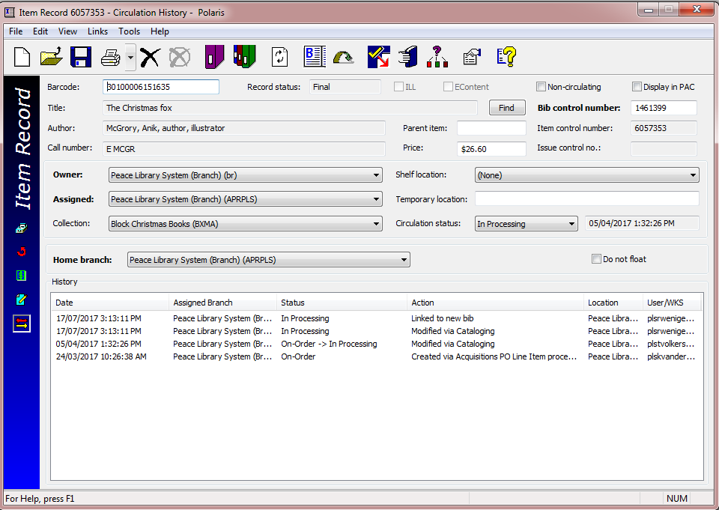
Item record – History view
Notice three places where Polaris identifies the “owner” of this item!
1.
2.
3.
As your item circulates this area will fill up with circulation history!
This is cleared annually by headquarters.

Slide 12
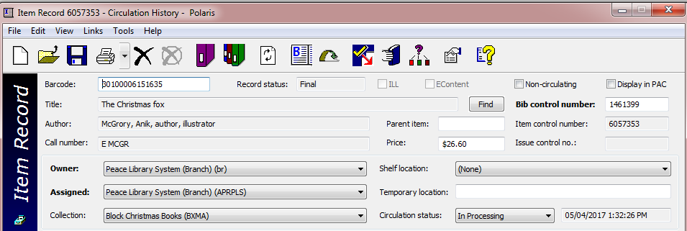
The item control number is what Polaris uses to distinguish between your item and an item belonging to another library. If you have two copies of the same book, each will have a different barcode and each will have a unique item record!
Bibliographic (Bib) record #1461399 provides the title and author information. For this item record to be correct, it must include the correct Bib control number.

Slide 13
Our item record example derives its title and author’s name from the Bibliographic (Bib) record to which it is linked.
If you scan this barcode you should see this title and author. If you see a different title and author, the Item record is linked to the wrong Bibliographic record. If you change the Bib control number, title and author change.

Slide 14
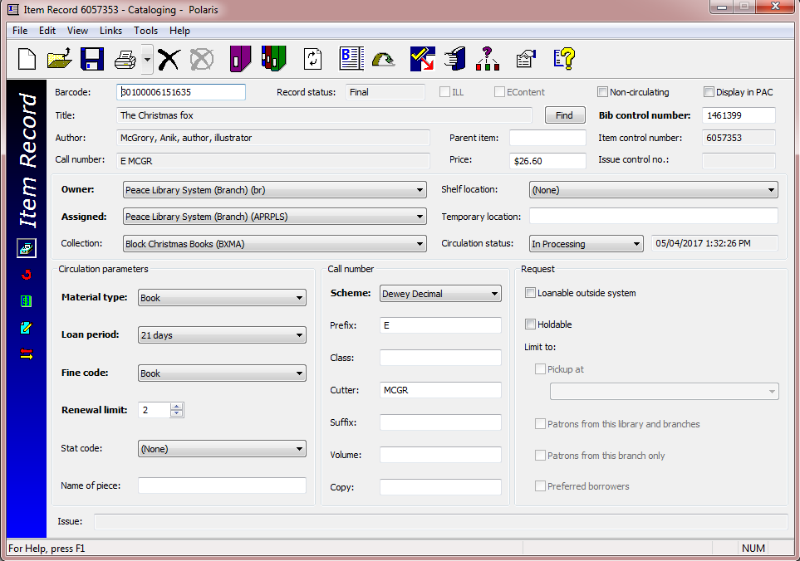
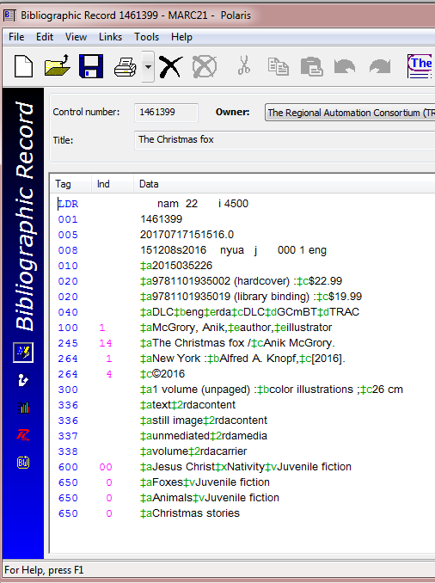
An Item record linked to the correct Bibliographic record
Start with the correct Bibliographic record to create a good Item record!

Slide 15
What is a Bibliographic Record?

Slide 16
What is a Bibliographic (Bib) record?
A Bib record contains specific information about a book, (or magazine, audio book etc.) that is owned or “on order” by one or more libraries.
Most Bib records in the Polaris database represent one specific edition of an item (usually identified by a unique ISBN as found on the item).
Some Bib records represent many issues or editions of an item (like a monthly or yearly publication). These will be the focus of part two of “Creating and Editing Item Records”.
All item records are linked to a Bib record by the “Bib control number”.
The first step in adding a new item is to find a matching Bib record in the Polaris database.
The next slide shows a Bib record in the default (MARC) view.

Slide 17
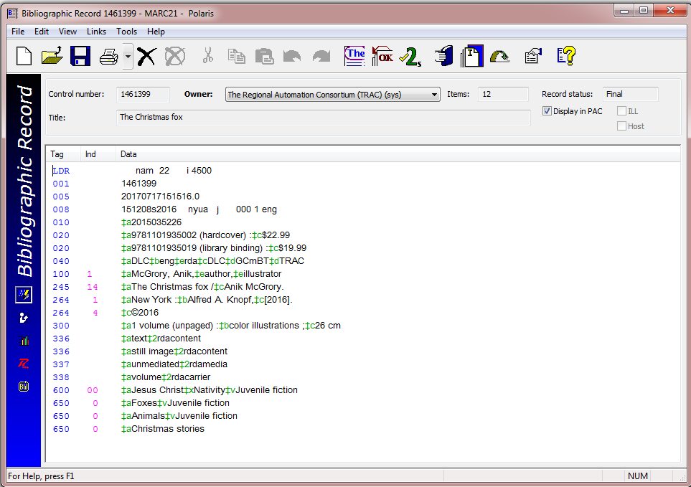
Bib record (#1461399) MARC (MAchine Readable Cataloguing)view
The Polaris “machine” can read this data by using the numeric tags that are in the first column. Familiarize yourself with these “tags”:
001 – Bib control #
020 – ISBN
100 – Author
245 – Title
264 – Publisher
300 – Physical data
500’s – Summary
600’s – Subject
700’s - Illustrator
A complete Bib record should have most of these tags.

Slide 18
Bib record # 1461399 – MARC (default) view
Note the icons on the blue side banner.
Clicking on the second icon opens the record in the PAC (Public Access Catalogue) view.
The PAC view is shown on the next slide-this is what patrons see online…

Slide 19
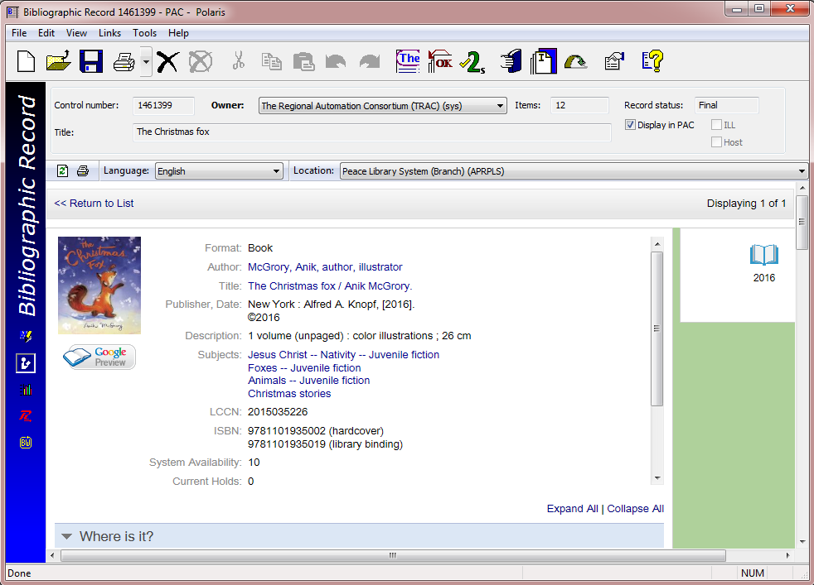
Bib record # 1461399 – PAC view
In this view a photo of the item cover is often seen, as well as an icon which is derived from the cataloguers codes in the MARC record, informing Polaris that the item in this case is a book. Other information from the Bib record is shown without the tag numbers, in this expanded view. Patrons scroll down to see owning libraries.

Slide 20
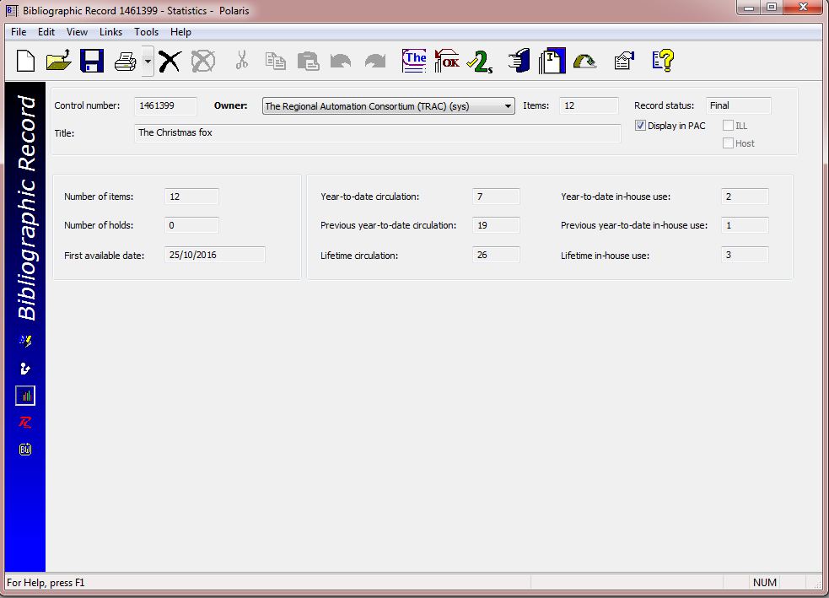
Bib record #1461399 – Statistics view
The third, statistics, view of the Bib record workform shows the circulations statistics s of all 12 linked items. The next two views (Resources and Bound-with) are little used in TRAC.

Slide 21
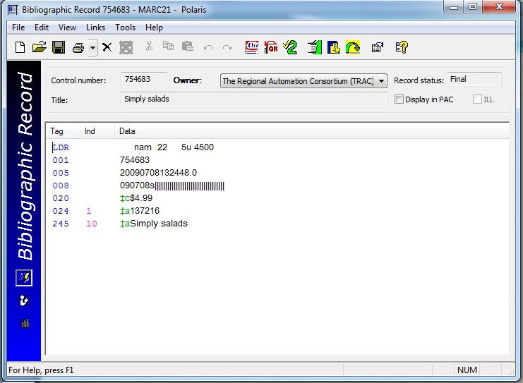
Incomplete Bib record
Look what is missing in this example:
No Author (100 tag)
No ISBN (020 tag, subfield a)
No publisher (260 tag)
No physical description (300)
No subject description (600’s)
Do NOT add your item record to an incomplete
Bib Record!
If this is the ONLY Bib record you can find for “Simply Salads” please send the item to headquarters for cataloguing.

Slide 22
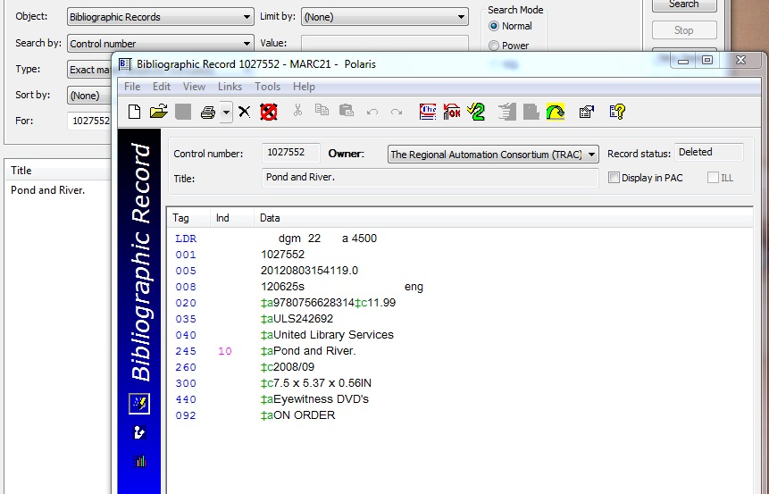
Incomplete Bib record – “On Order” record
Look what is missing in this example:
No Author (100 tag)
No publisher (260 tag)
No physical description (300)
No subject description (600’s)
Do NOT add your item record to an “on order”
Bib Record!
If this is the ONLY Bib record you can find for “Pond and River” please send the item to headquarters for cataloguing.

Slide 23
Searching for a Bibliographic Record

Slide 24
How to search for a complete Bib record
Examine the item to be added carefully so your search for the correct Bib record is successful.
Check the front and back covers and the title page.
Also check the reverse of the title page (Tp. verso). Search by ISBN!!

Slide 25
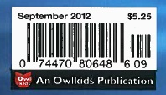
What is an…ISBN?
…a barcode? …a UPC code?
A barcode is 14 digits long, and has your library code in the 2,3,4 and 5th positions to identify items which belong to your library. (PLS = 0100)
UPCs (Universal Product Codes) are 12 digit numbers found on most items you purchase and are used at store tills to scan an item’s price.
An ISBN (International Standard Book Number) is a 13 digit number which uniquely identifies each book published. Look for “978” at the beginning of the string. Some older books may have a similar 10 digit number, or both. (ie. 9780375834479, and 037583447x). DVD’s may have a 10 digit ISBN (not scannable) found above the UPC code. Magazines and serials have a similar “ISSN code” (International Standard Serial Number) found inside the publication.

Slide 26
Start by launching a Bib record find tool
Open a Bib Record Find Tool, by clicking on its icon (after clicking the blue button):
Or by choosing “Bibliographic Records” on the Cataloguing dropdown menu:
Or by clicking on F12 (Function key on the top of your keyboard)

Slide 27
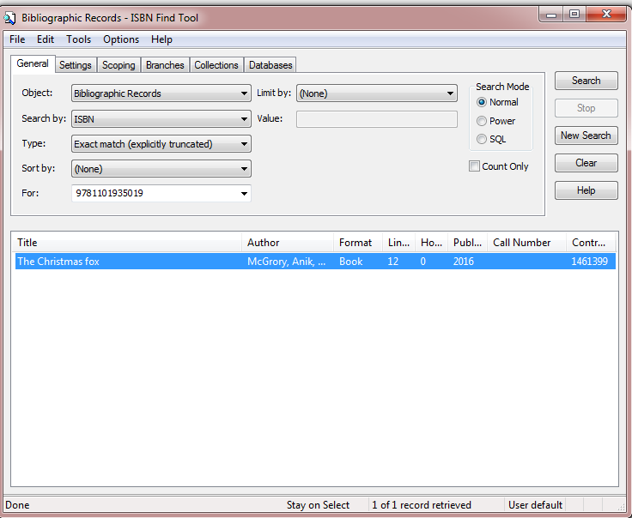
Use the drop down menu in the “search by” field to search by ISBN.
Enter the ISBN in the “for” field, preferably by scanning.
If you must enter the ISBN manually, do not use spaces or any other character, unless it is a letter x at the end of the numeric string.
Be sure you are scanning an ISBN…

Slide 28
Usually there will be one result in the find tool window. Double click on the result to open the Bib record.
If there are no results, send the item in to headquarters for cataloguing.
If there are more than one result, read each Bib record carefully to choose the best one.

Slide 29
When there are more than one Bib record with the same ISBN…
Open each record and compare the item in hand to the detailed information in the Bib.
Avoid adding to (older) Bib records which contain multiple ISBNs (and therefore multiple formats … hardcover, softcover, etc.)
Do not add items to incomplete or “on-order” records.
If you cannot find a good matching Bib, send the item to headquarters for cataloguing.

Slide 30
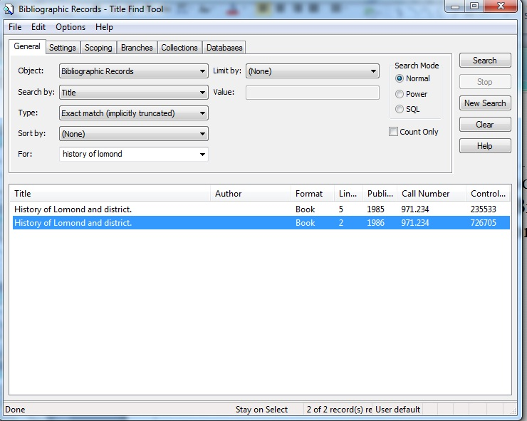
Items with no ISBN
Occasionally self published volumes or older books do not have ISBNs.
Change the Bib record search tool parameter to “Title” or “Author”. In this example, choosing the appropriate publication date (1985 or 1986) should be the correct choice. Regardless, open the Bib record and compare it to the item in hand.
Spelling must be very accurate for title searches to work. Note that the search engine found the full title, although only the first three words were entered.

Slide 31
Creating an Item Record

Slide 32
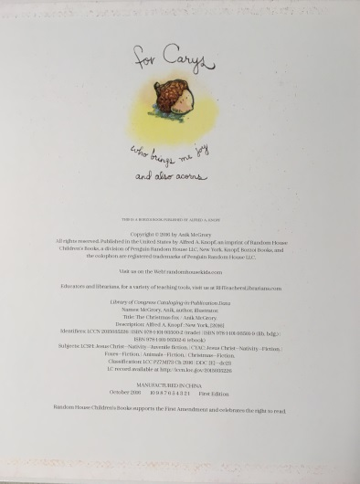
Introducing the three step process. Every time you add an item record:
Examine the item in hand. (Both covers & both sides of title page. “The Christmas fox” had it’s Cataloguing-in-Publication (CIP) data on the inside of the back cover, instead of the back of the title page.)
Find the correct Bib record by searching for the ISBN in Polaris. Keep referring back to the item to ensure accuracy.
Create a correct item record, and save it.
Inside back cover
or Tp. verso
Cover
Back Cover
Title page

Slide 33
Compare your item to the Bib record
Check for these important tags:
245 - Title
100 - Author
700 - Illustrator
264 - Publisher
300 - Physical description
600s – Subjects
Newly published books should have more than one 300 tag to indicate RDA cataloguing standards compliance.

Slide 34
Find the perfect match?
=
ISBN
Title
Author
Illustrator
Publisher
Year of publication, place
Format or description (book, or DVD?)
Dimensions, number of pages
Once you are convinced that you have the correct Bib Record, you are ready to “create” a new item record, which will be automatically “linked” to this Bib record.
Your item will then be listed along with all the other books that are also linked to the same Bib record.

Slide 35
Create your item record
From the icons across the top of the Bib record, click on the “Create Item Record” icon,
OR
choose “Create Item Records” from the “Tools” drop down menu.

Slide 36
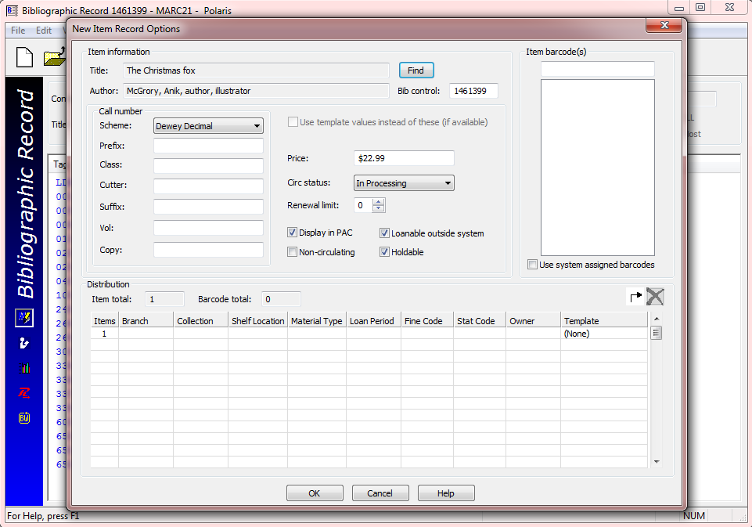
Completing the Item Record Work Form
Choose a template from the dropdown menu, which will populate every field in the line: Branch, Collection, Material Type, Loan Period, Fine Code and Owner. (Stat code is not used in TRAC)
On this workform or on the item record that is created and is shown after clicking on OK, the barcode, the call number, and the renewal limit are also required.

Slide 37
Item record – new record view
In this screen select the template you want to use. This will automatically populate the distribution fields.
Click on OK to create the item record.

Slide 38
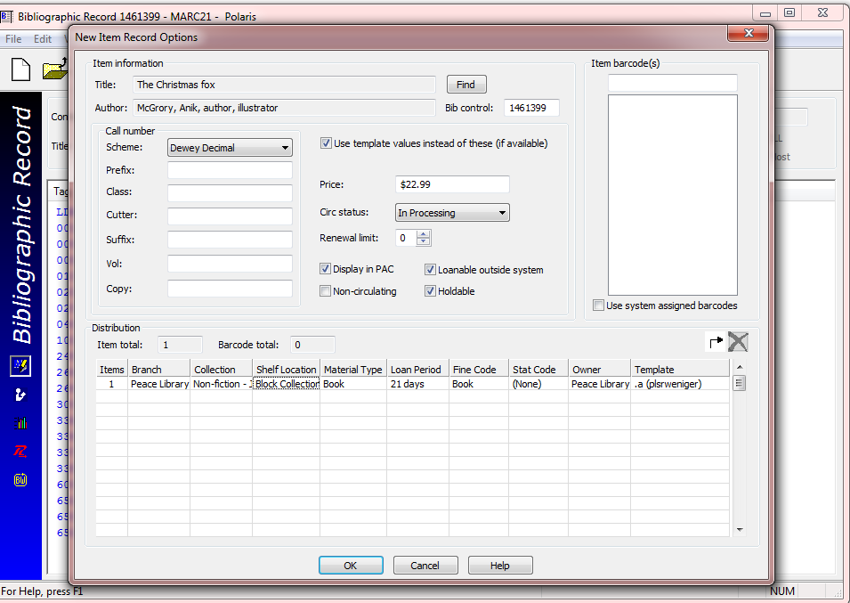
Item record with data fields populated.

Slide 39
Item record with data fields populated.
Scan in the new item barcode, enter call number information and renewal limit according to your library policy. These three details can also be done in the item record, next screen.
Click on OK to create your new Item record.

Slide 40
Completing the Item Record Work Form
If not already done, scan in the new barcode.
Although this number can be entered manually, it is best to scan the barcode to ensure accuracy.
Polaris recognizes an acceptable barcode format and when you are saving the record, will warn you if you have used too short or too long a number in this field. (ie: the ISBN)
Affix the barcode on the item well away from the ISBN and the UPC codes. PLS member libraries have agreed to use the top right corner on the back cover for barcode placement.

Slide 41
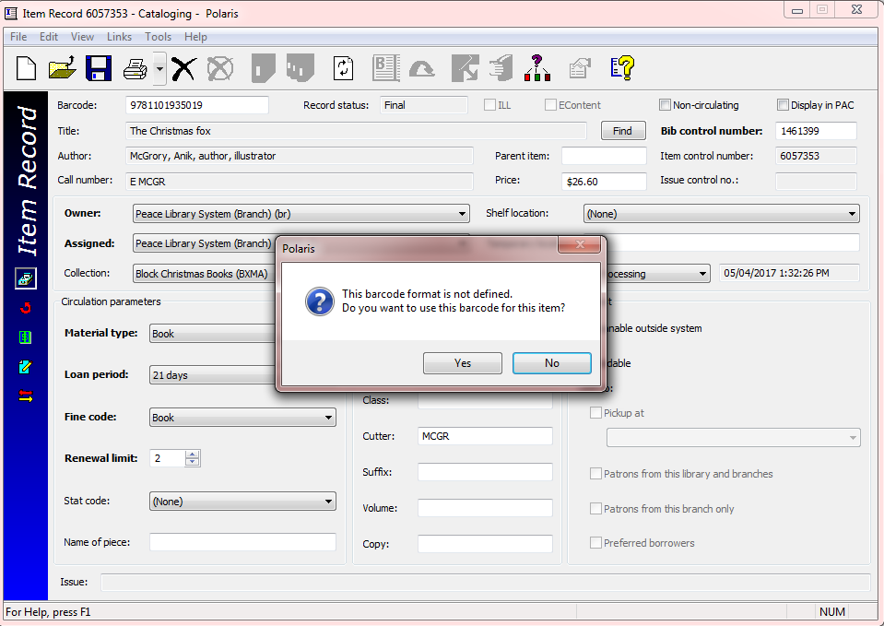
Completing the Item Record Work Form
Scan your library barcode to ensure accuracy. Do not scan the ISBN, as is shown here.
Affix your barcode away from the ISBN code.

Slide 42
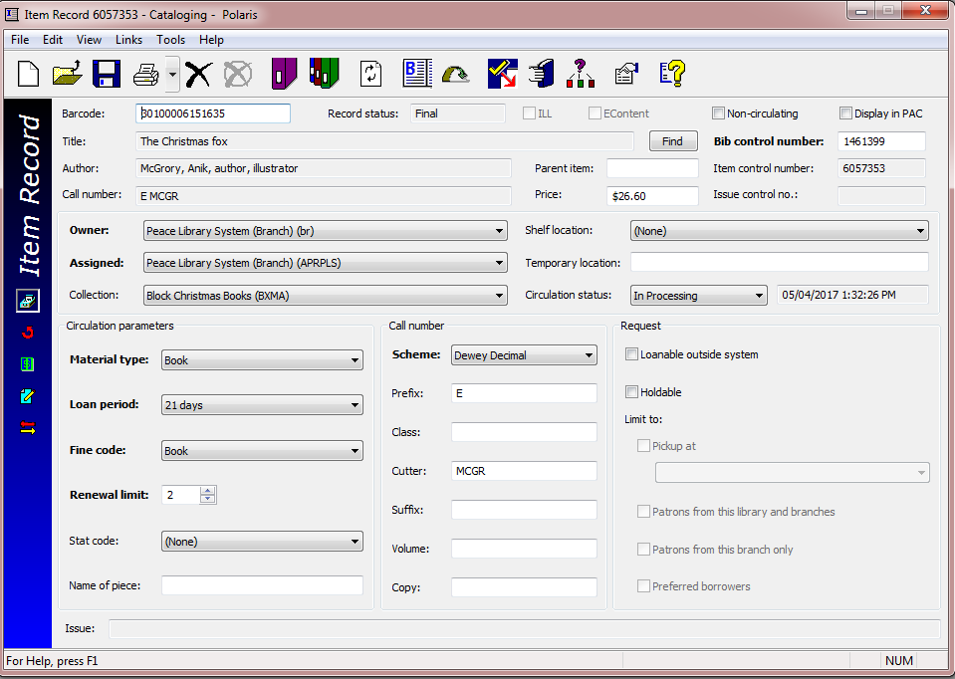
Completing the Item Record Work Form
Enter the price of the item in the field shown using the following “monetary” format: x.xx (Polaris will add the dollar sign).
If no price is on your item, estimate a replacement cost.
The price is important if the book is lost and a patron has to be charged for the item, and for reports valuing your collection.

Slide 43
Completing the Item Record Work Form
From the drop down list choose the appropriate collection code for this item.
Contact your consultant if there is a collection code you would like to have, which is not on the drop down list.

Slide 44
Completing the Item Record Work Form
From the drop down list choose the appropriate shelf location for the item.
Not all libraries use shelf location information.
If you do, and there is a shelf location you would like to have on your drop down list, contact your consultant.

Slide 45
Completing the Item Record Work Form
Note the default circulation status of a new item record:
“In Processing”.
Do not change this drop down choice from “In-processing”.
Use a Check In screen to “check-in” the item after you are finished saving it, so that any holds placed on the Bib record can be satisfied.

Slide 46
Completing the Item Record Work Form
Next, select the correct “Circulation Parameters” for the item. Your template may have populated these fields already.
Notice how often Polaris provides drop down boxes to populate database fields!
This is to prevent typing mistakes – databases perform best when fields are accurately filled in!
Choose the correct:
Material Type
Loan Period
Fine Code
Renewal Limit
Material Type and Fine Code are always the same.

Slide 47
Completing the Item Record Work Form
Finally, fill in the call number information, before saving your new item record!
These fields will create the spine label for your item, and there are no drop down menus to ensure accuracy!
Each field should ONLY contain the data it is designed for if the search engines are to work properly. BE CAREFUL!

Slide 48
Completing the Item Record Work Form
Scheme: Dewey Decimal.
The scheme should not be changed – TRAC currently uses this classification system throughout the entire collection.
Prefix: Enter the correct prefix for the item as used for similar items in your library. Use CAPITAL letters and do not enter unnecessary spaces in this field.
Prefix examples:
-FIC (Fiction)
-F (Fiction)
-E (Easy)
-LP (Large Print)

Slide 49
Completing the Item Record Work Form
Enter the Dewey Decimal Classification Number in the “Class” field, if applicable. Typically this field is NOT used for Fiction nor for Easy Non-Fiction.
Use the following format:
xxx.xxxxxx Use no spaces, and no other characters between the digits.
Some libraries abbreviate to a maximum of three digits after the decimal point, others use all.
The class field should never end in zero (0). If there are only three digits, leave off the period. (ie: 379)

Slide 50
Completing the Item Record Work Form
Enter the “Cutter” - If the item has an author in the author field at the top of the work form, use the CAPITALIZED first three letters of the last name.
If there is no author, as is the case in some multi-authored publications, use the CAPITALIZED first three letters of the title.
In this example, McGrory is the last name so a four letter cutter, MCGR is correct. This is the practice for all names starting with Mac or Mc.
Again – no spaces and two to four CAPITAL letters only should be used in this field.

Slide 51
Completing the Item Record Work Form
Enter the “Suffix”, if used.
The suffix field is not used for sorting by Polaris, so formatting issues are not stringent. It is still good practice to use internal standards so your spine labels look orderly. Lowercase characters are acceptable in this field.
Some example suffixes found in the TRAC database:
k-2
Season 1
Gr. 5-7
c.2
v.3

Slide 52
Completing the Item Record Work Form
The volume field is a particularly sensitive field. It is used for multiple part (multi-part) publications. This book is complete in one volume, so no volume information is required. Keep your cursor out of this field!
The guidelines for usage of the volume field will be covered in part two of “Creating and Editing Item Records”.
If you enter something in the volume field by mistake, be sure to fully delete the contents because the field is “space sensitive”. (Even one space will disrupt Polaris search processes - backspace your cursor to remove “spaces”.)

Slide 53
Completing the Item Record Work Form
Complete the “Copy” field, if necessary. Usually, if you have only one copy of this book in your library, this field is not necessary.
The standard format for this field is “lower case c”, followed by a period, and then the copy number. No spaces allowed:
c.1 or c.2
When adding a second copy, it is good to edit the item record for copy 1 with copy information.
“Editing” is covered in part two of “Creating and Editing Item Records”.

Slide 54
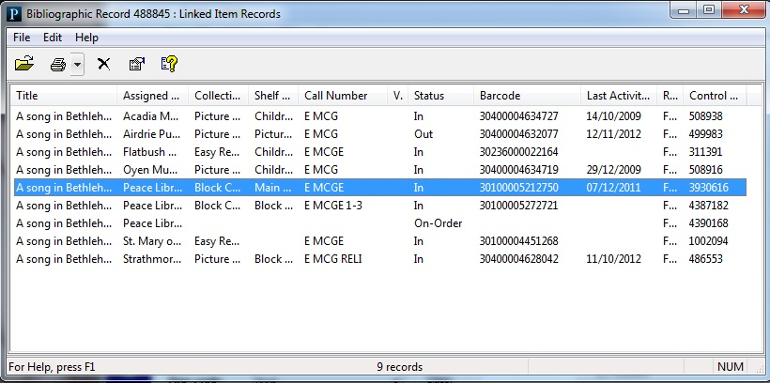
Completing the Item Record Work Form
At this time, Polaris does not show the copy field in the list of linked items attached to a Bib record, unless the copy information is added to the suffix field.
If it is important to have this detail on your reports, and in this list, please use the same format (c.#) in the suffix field for your copy number.
Note the “on-order” record on this list of items linked to Bib #488845. NEVER open and edit this record to create the item you are adding to the database.

Slide 55
Completing the Item Record Work Form
Three check boxes to look at before saving:
Display in PAC
Loanable outside system
Holdable
These must be checked for your item to circulate.
Do NOT check non-circulating, unless the item is not meant to circulate according to the TRAC Operational Guidelines.

Slide 56
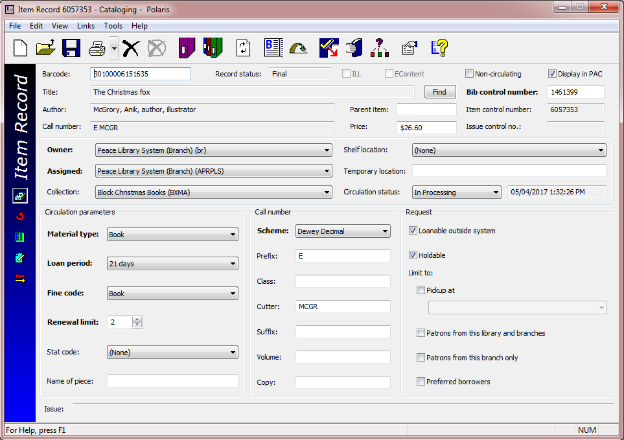
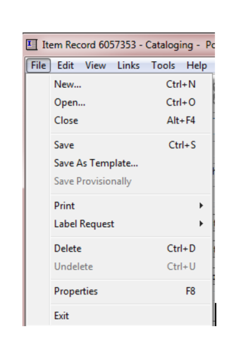
Completing the Item Record Work Form
Three ways to save:
Choose “Save” from the File Drop down menu
Click on the “save” icon.
Ctrl + s

Slide 57
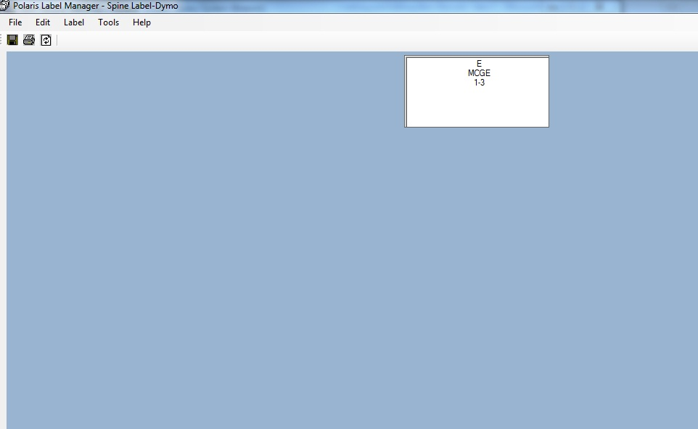
Completing the Item Record Work Form
Print the spine label.

Slide 58
Review the Three Step Process

Slide 59
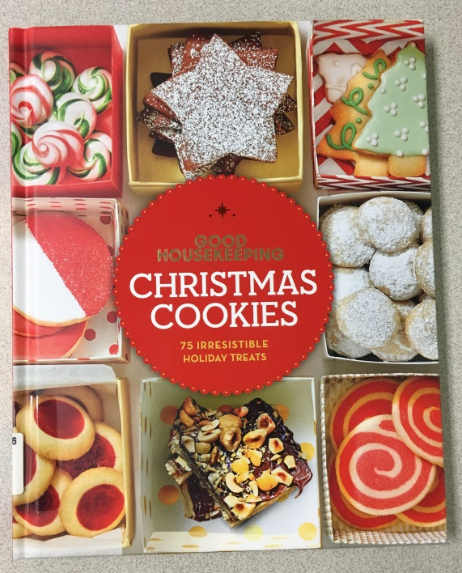
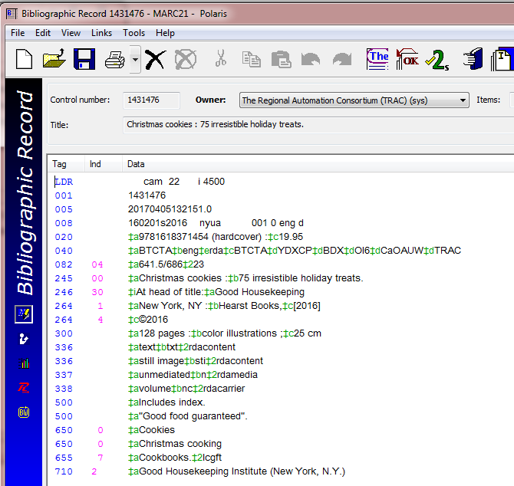
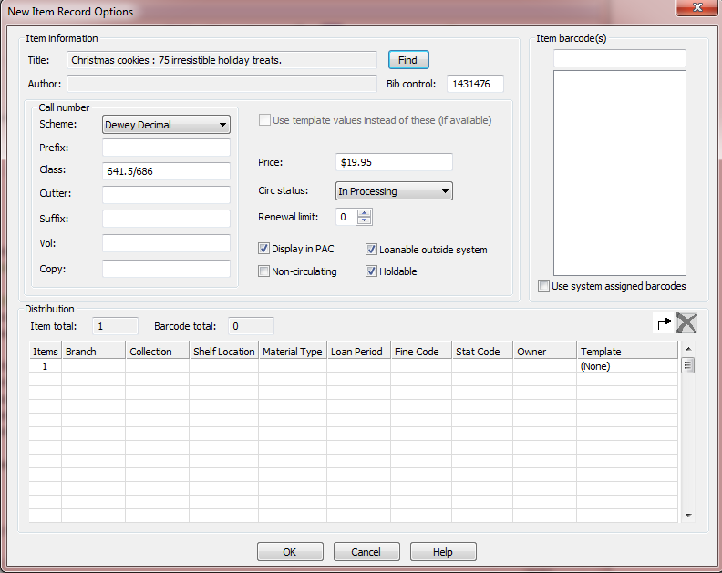
Follow this three step process every time you add an item record:
Examine the item in hand.
Find the correct Bib record by searching for the ISBN, and keep referring back to the item to ensure accuracy.
Create a correct item record, and save it.

Slide 60
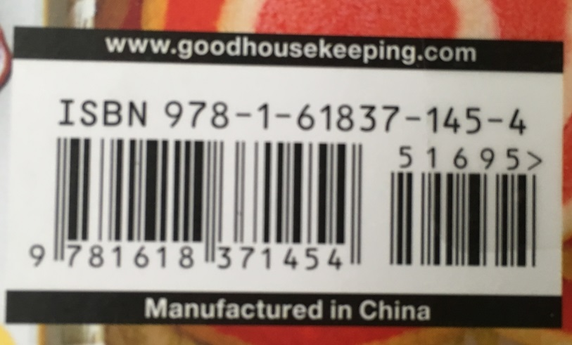
Step one:
Examine the item in hand – scan the 13 digit ISBN found on the back cover to find a Bib record, using a Bib find tool, to search.
If there is an ISBN, and you do not find a record, send the book to headquarters for cataloguing.
The ISBN may also be found in the information behind the title page.

Slide 61
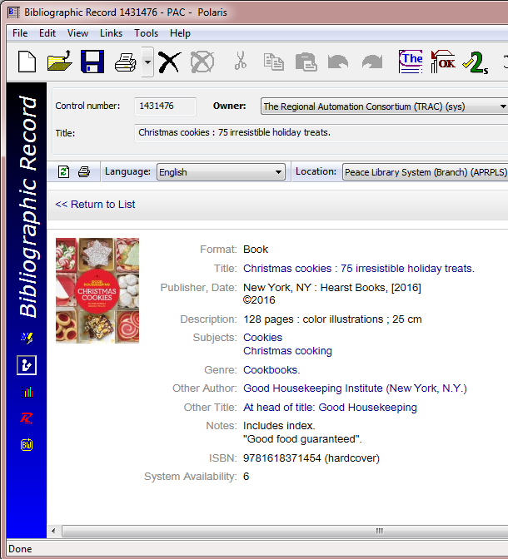
Step two:
Compare your item to the Bib details. Check: format, number of pages, edition (large print).
Cataloguers rely on the title page (rather than the book cover, or spine) to ascertain the correct title, sub-title and author.
Title & sub-title may or not be on the cover. Cataloguers use the title page in creating a Bib record.
(245 tag in the MARC view)
The physical description of the item (# of pages, size, illustrations, etc.) should describe the item in hand.
(300 tag in the MARC view)

Slide 62
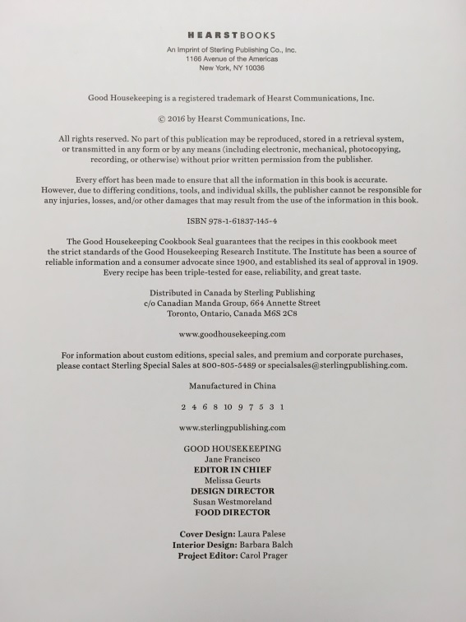
Check the subject headings and other information on the Bib record.
Also look at the Tp. Verso (reverse side of the title page) for subjects, classification and other details.
Tp. verso
This Bib record is a perfect match for this new item! Now to add the item by creating a new item record.
Click

Slide 63
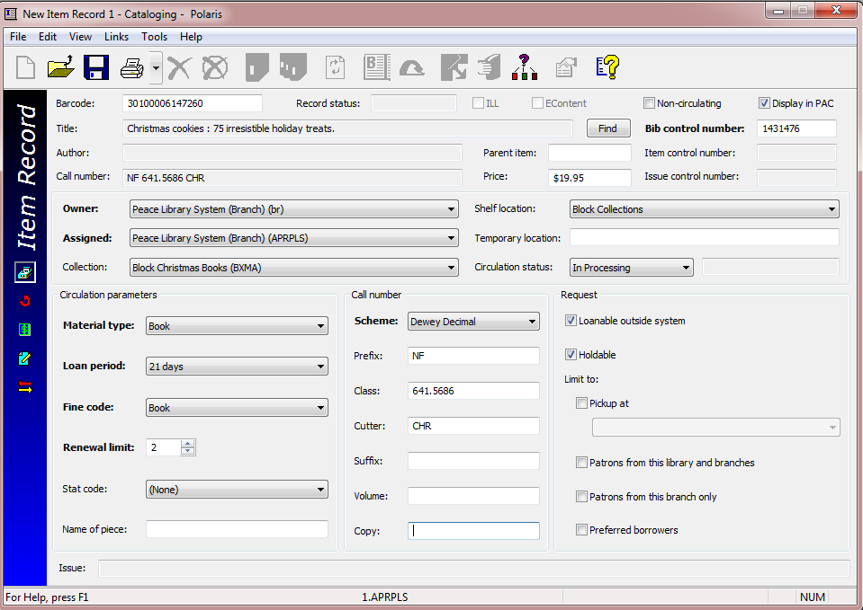
Step three:
Create a correct item record, and save it.
Affix and scan your barcode
Add the price
Choose collection code and shelf location
Choose the four circulation parameters from the drop down menus
Add prefix (NF) (if required)
Remove the slash (/), spaces or punctuation marks from the class field
Type in the cutter (CHR)
Confirm the three check boxes on the right
Save the record and check in your new holding!
Now Bib record 1431476 has a new item link!

Slide 64
Audiobook, item in hand:
Details to find:
Title (and subtitle)
Author
Narrator
The full book or an abridgement?
Number of discs
Number of hours
Publisher
Search by:
Search by ISBN whenever possible. Multiple results are common! Take time to examine each Bib thoroughly.

Slide 65
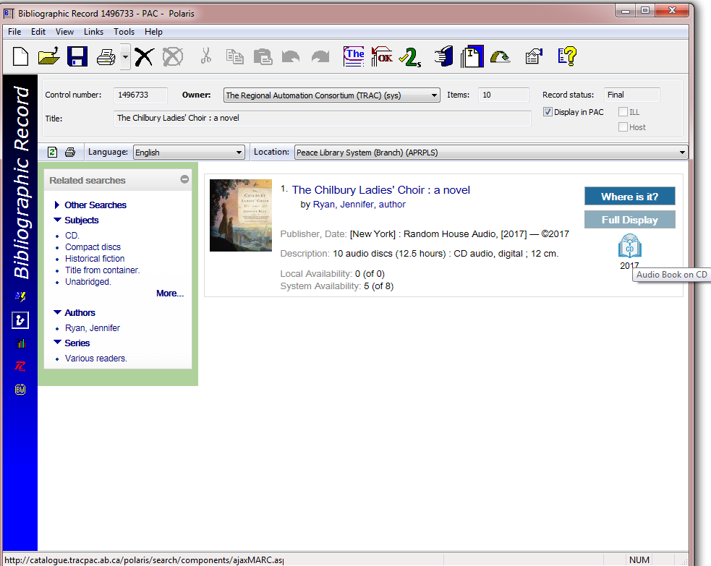
Audiobook, Bib record:
Details to find:
Audiobook format icon
Title (and subtitle, if there)
Author and Narrator
The full book or an abridgement?
Number and size of discs
Number of hours
Publisher & publication date
Do not link to Bib 1496733, unless all the details are correct, for the audiobook you are adding!
Use the scroll bar in the MARC view and “ Expand All” in the PAC view to find more information about this Bib record.

Slide 66
Audiobook, item record:

Slide 67
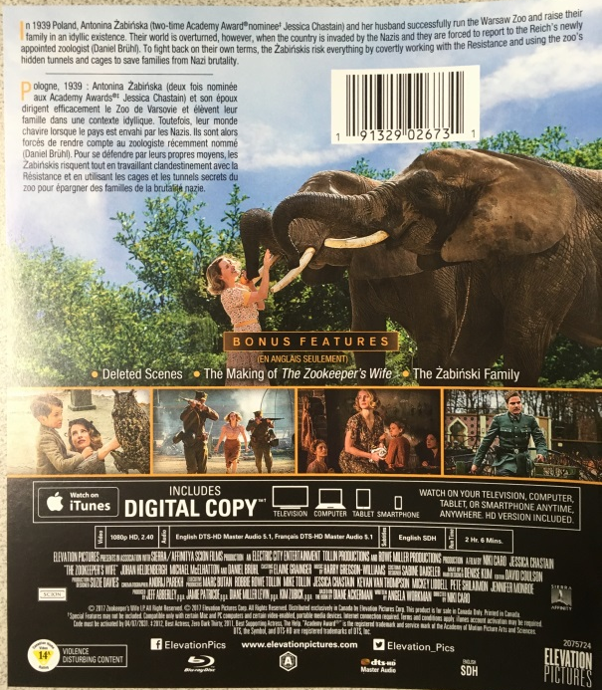
Blu-Ray, item in hand:
Details to find:
Title (and subtitle)
Cast
Format
Number of discs
Number of hours
Publisher
Search by:
Search by scanning the UPC code, (choose UPC from the search parameter drop down menu).
For Blu-Rays and DVDs you may also search by title. For a match watch for film distributor, languages and number of discs.

Slide 68
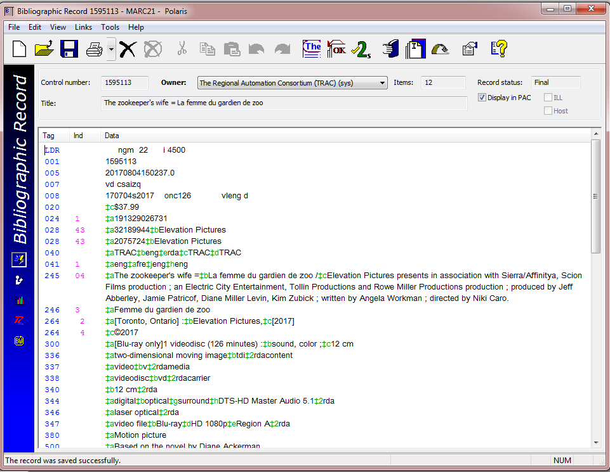
Blu-Ray, Bib record:
Details to find:
Title (and subtitle)
Language
Producer and director
Special features per cover detail
Number and size of discs
Number of hours
Publisher and year
Format – DVD or Blu-Ray
Multiple formats:
If your movie contains multiple formats (DVD and Blu-ray or MP3) you must watch the next part of “Creating and Editing Item Records” before adding your item!
Should a DVD movie or a Blu-Ray/DVD combo-pack be linked to this Bib record (# 1595113)? ... NO!

Slide 69
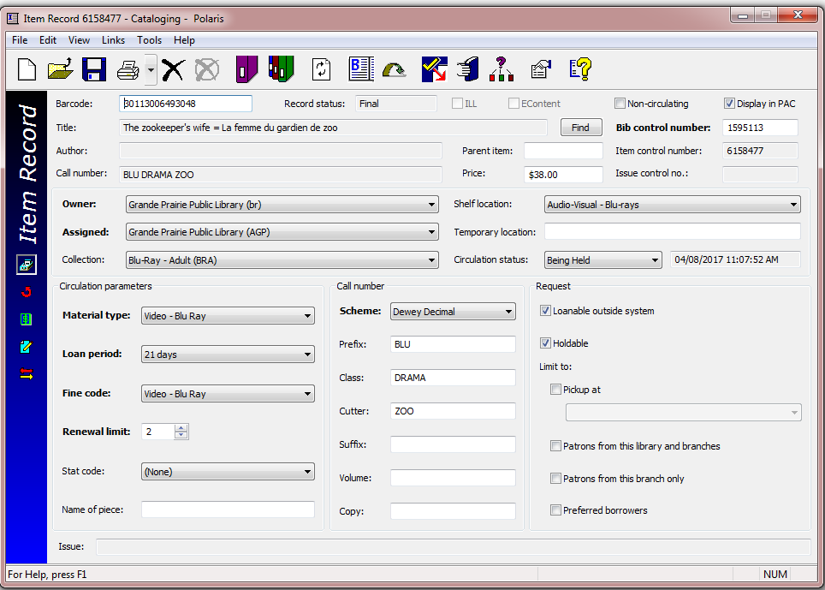
Blu-Ray, item record:

Slide 70
Quiz

Slide 71
Search in Polaris for the answers to this short quiz…
Name the “author” and “publisher” of ISBN # 9781501131424?

Slide 72
Search in Polaris for the answers to this short quiz…
2. What is the “format” and the “Bib control #” of ISBN # 9781250132604?

Slide 73
Search in Polaris for the answers to this short quiz…
3. Who is the “publisher” and what is the “physical description” of ISBN # 0788859544?

Slide 74
Search in Polaris for the answers to this short quiz…
4. In an item record screen which three fields are automatically populated by the Bib record:
a) Material type, owner and title.
b) Title, author and bib control number.
c) Title, circulation status and fine code.
d) Barcode, title and Bib control number.

Slide 75
Search in Polaris for the answers to this short quiz…
5. What are the three steps for adding an item record?
a) Read the title, search for the item by title, and find an item record to use.
b) Examine the physical copy, find a matching Bib record, create a new Item record.
c) Look for an ISBN, scan it, pick a Bib record with no links, and add the item.

Slide 76
Search in Polaris for the answers to this short quiz…
6. Which Item record fields are space sensitive?
a) Suffix and Shelf location
b) Fine code and Collection code
c) Volume and Classification

Slide 77
Search in Polaris for the answers to this short quiz…
7. Which Item record fields must be CAPITALIZED?
a) Suffix and Copy
b) Cutter and Prefix
c) All of the above.

Slide 78
Quiz questions…
Name the “author” and “publisher” of ISBN # 9781501131424?
What is the “format” and the “bib control #” of ISBN # 9781250132604?
Who is the “publisher” and what is the “description” of ISBN # 0788859544?
In an item record screen which three fields are automatically populated by the Bib record:
a) Material type, owner and title.
b) Title, author and bib control number.
c) Title, circulation status and fine code.
d) Barcode, title and Bib control number.
What are the three steps for adding an item record?
a) Read the title, search for the item by title, and find an item record to use.
b) Examine the physical copy, find a matching Bib record, create a new Item record.
c) Look for an ISBN, scan it, pick a Bib record with no links, and add the item.
Which Item record fields are space sensitive?
a) Suffix and Shelf location
b) Fine code and Collection code
c) Volume and Classification
Which Item record fields must be CAPITALIZED?
a) Suffix and Copy
b) Cutter and Prefix
c) All of the above.
Please try for 100% in this quiz before proceeding to Part two of “Creating and Editing Item Records”.

